Slide 1
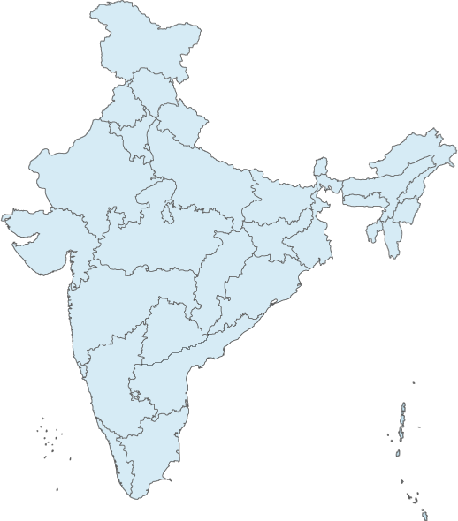
SISCOL's Growing presence
New Delhi
Bhilai
Corporate Office
Mumbai
Design Office
Hyderabad
Manufacturing Units
Bengaluru
Marketing Offices
Chennai
Installation center

Slide 2
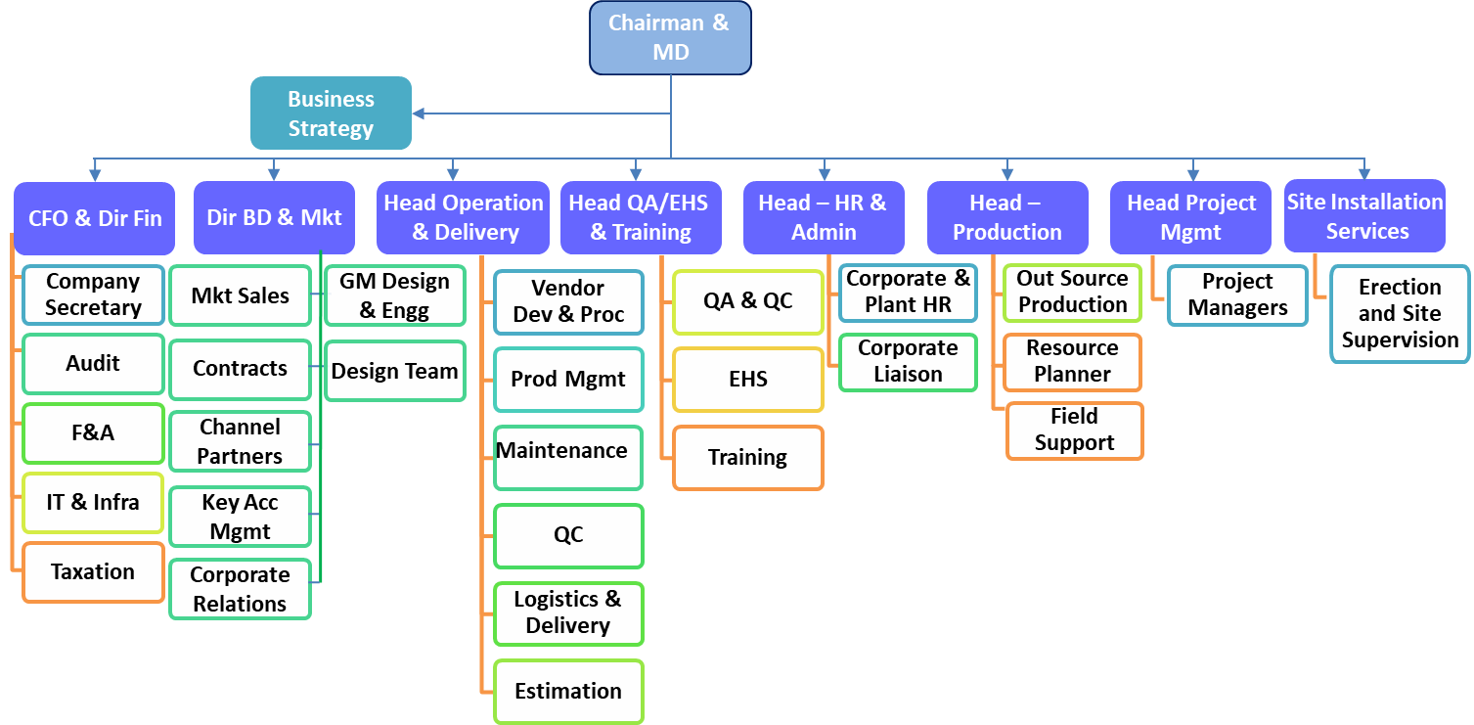
Organization Structure

Slide 3
Manpower: By Age and Location
Age Group | No. of Emp | %age
<=30 | 123 | 46%
31 - 40 | 104 | 39%
41 - 50 | 33 | 12%
51 - 65 | 5 | 2%
Region | No. of Employees | %age
CENTRAL | 123 | 46%
EAST | 61 | 23%
NORTH | 34 | 13%
SOUTH | 28 | 11%
WEST | 19 | 7%
85% employees : <=40yrs of age.
A healthy mix of employees representing different regions
Date-
Presenter- Anand Shukla

Slide 4
ORDERS BOOKED IN Q1
CUSTOMER | TYPE OF STRUCTURE | LOCATION | TONNAGE
DWARKA – 2 | DWARKA CONVENTION CENTRE -TRUSSES | DELHI | 2231
EDFC | OPEN WEB GIRDER BRIDGE | MEERUT | 1645
URC | HOSPITAL BUILDING STRUCTURE | ROURKELA | 504
KNRCL | OPEN WEB GIRDER BRIDGE | KARNATAKA | 1890
THYSSENKRUPP | INDUSTRIAL STRUCTURE | JHARKHAND | 1710
TECHNIP | INDUSTRIAL STRUCTURE | SINDRI-BARAUNI | 2400
 |  |  | 10380 MT

Slide 5
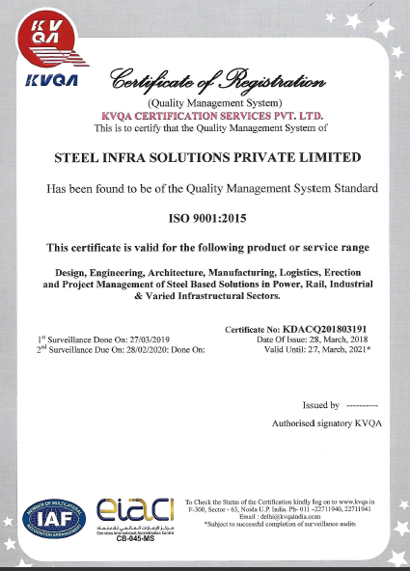
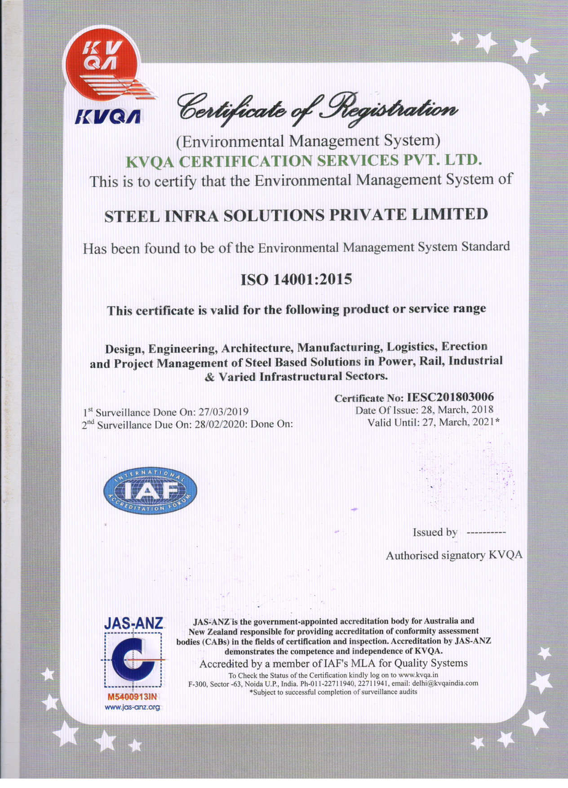
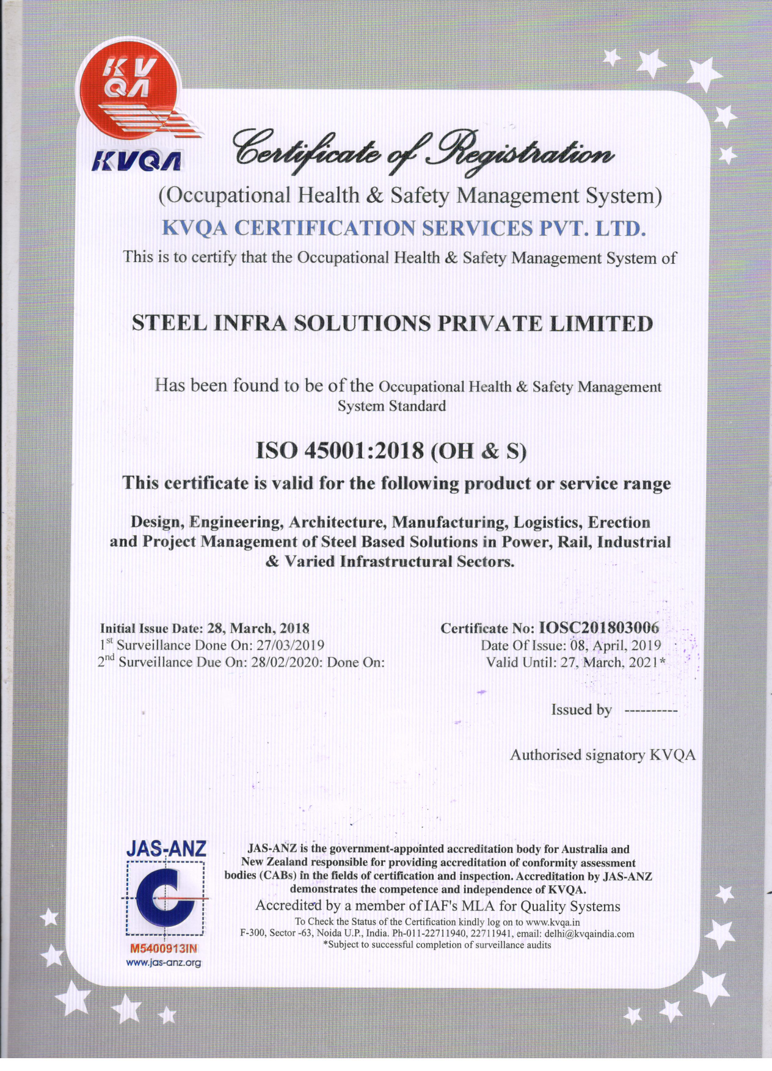
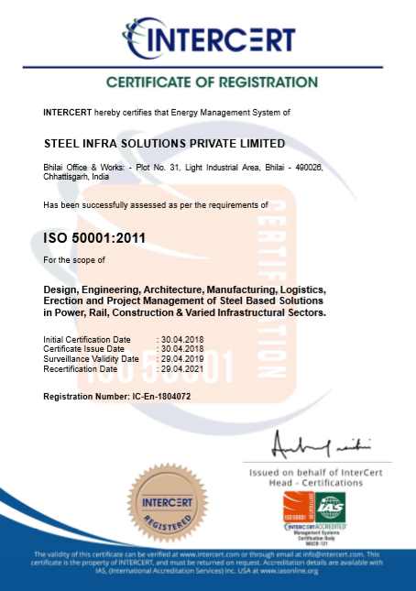
Integrated Management Systems Certifications
ISO 9001:2015
ISO 14001:2015
ISO 45001:2018
ISO 50001:2011
ISO 27001:2013
All units of SISCOL are covered under the scope of Integrated Management Systems (IMS)
Occupational Health & Safety Mangement System upgraded from OHSAS 18001:2007 to ISO 45001:2018
Certification agency conducted annual surveillance in April'19 and found “Zero” non-compliances

Slide 6
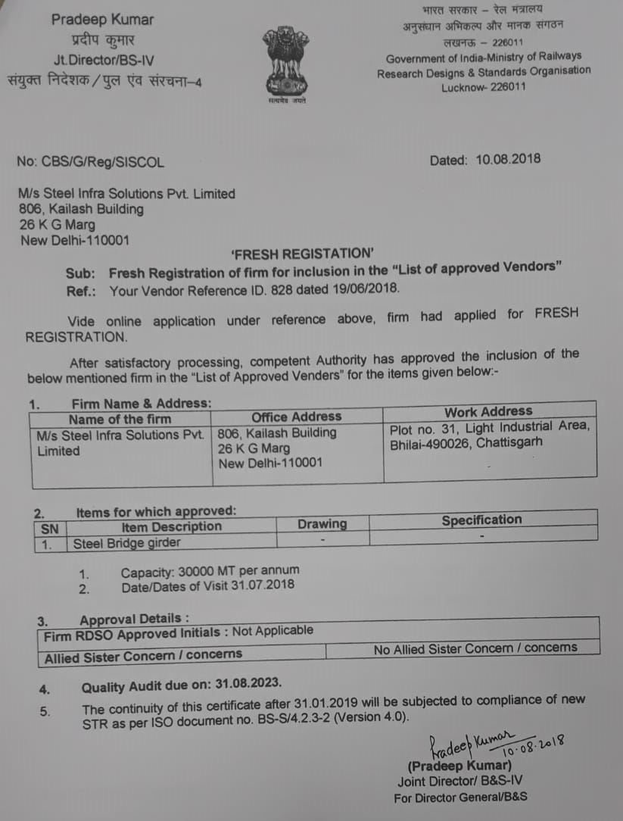
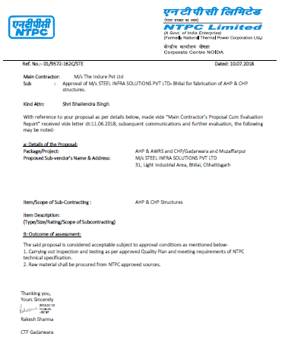
Customer Approvals
RDSO
NTPC

Slide 7
Validation by Customers (Plant Approval)

Slide 8
Third Party Inspection Agencies at SISCOL
NABL External Labs for Tests, approved by Clients
Shabri Enterprises, Bhilai (Mech, Chem, NDT-AERB Approved)
Perfect Inspection Services, Bhilai (NDT-NABL Approved)

Slide 9
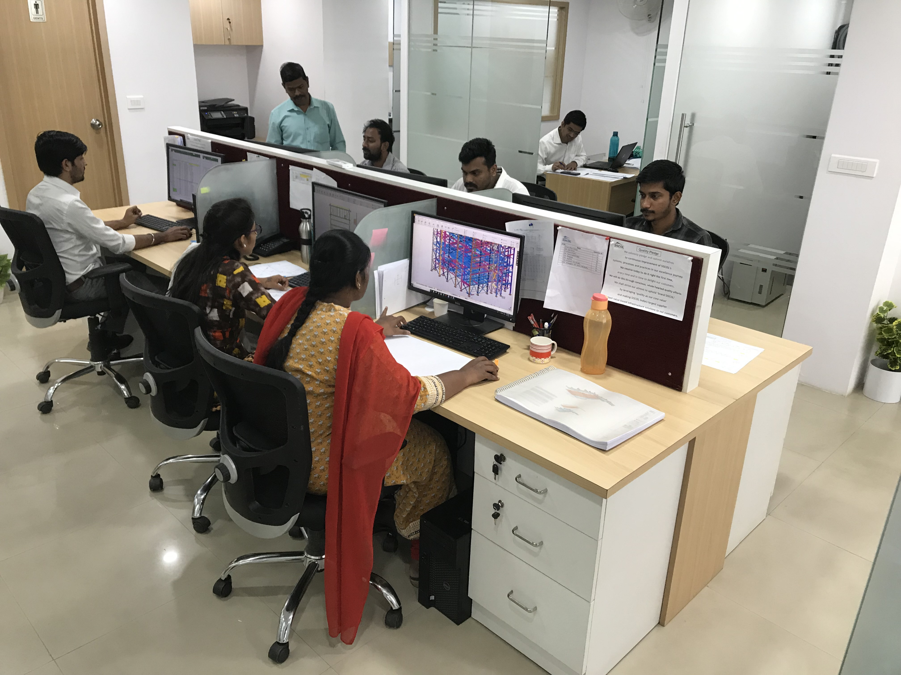
Design & Engg. Facilities
ANALYSIS AND DESIGN SOFTWARE:
STAAD.PRO, RAM STRUCTURAL SYSTEM, MICROSTRAN, LIMCON, ETABS
DETAILING SOFTWARE:
TEKLA, AUTOCAD
Team Strength: 15
Design Office @ Bengaluru

Slide 10
Factory Fabrication Facilities
Unit-1
7 Acres (28328 sq.m)
1500 - 1800 MT
Unit-2
4 Acres (16187 sq.m)
1200 MT
Unit-3
5 Acres (20234 sq.m)
1200 - 1500 MT
CNC Machines
Industrial, High Rise
GMAW, FCAW, SAW
Bridges
Franchises
Industrial, High Rise
GMAW, FCAW, SAW
GMAW, FCAW, SAW
7 Acres (28328 sq.m)
500 MT
Light Structures, Bridges
Total
21 Acres (93000 sq.m)
5000 MT
All Sectors
Full-Fledged
Equipments
SISCOL Units
Area
Maximum Production Capacity
Specialization

Slide 11
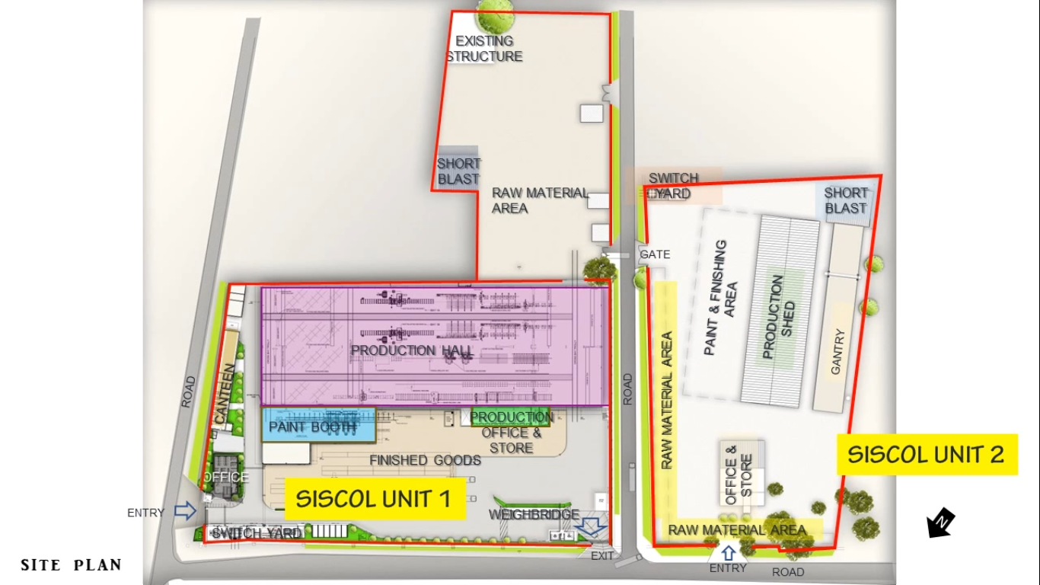
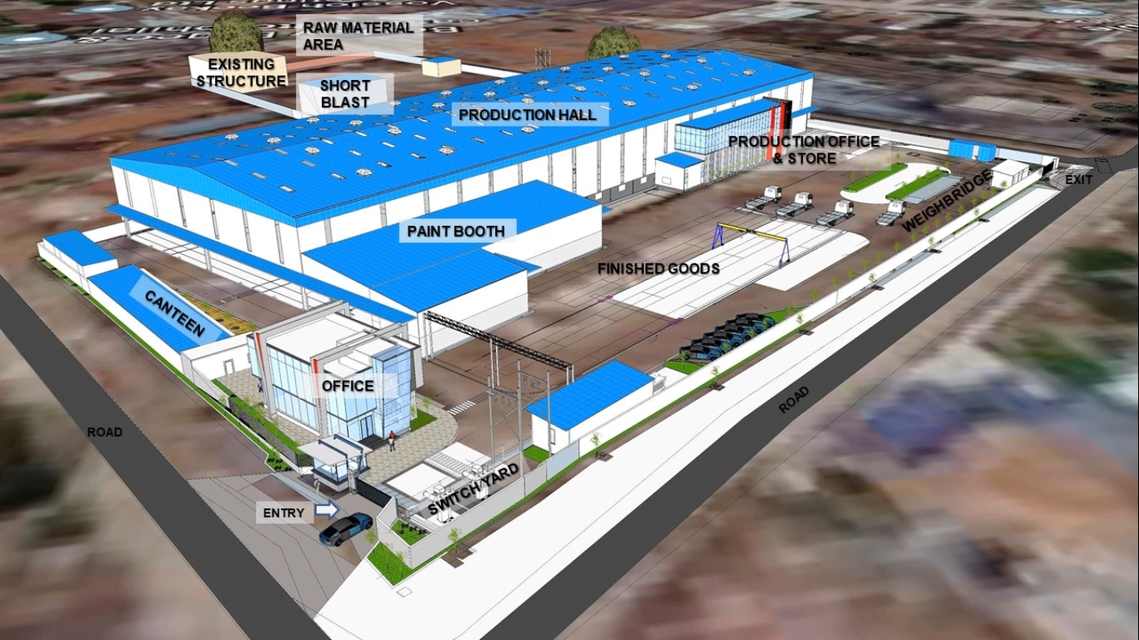
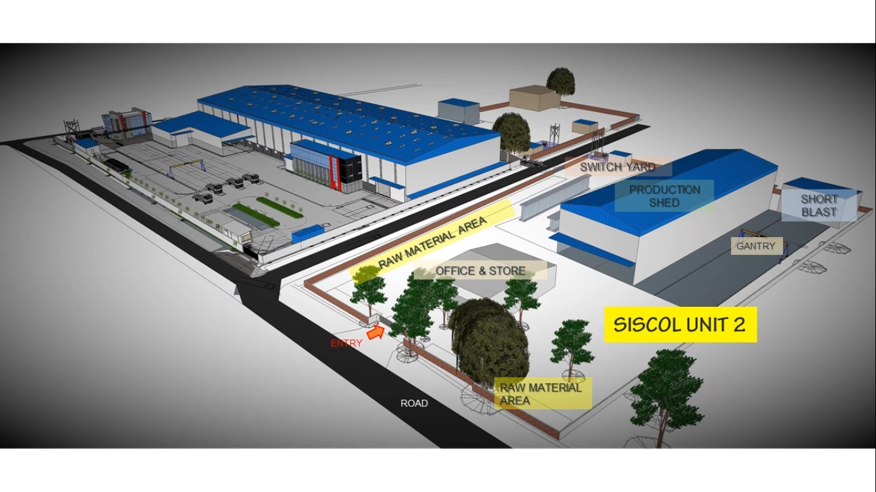
SISCOL UNIT 1
7 Acres (28,328 sq.m)
SISCOL UNIT 2
4 Acres (16,187 sq.m)

Slide 12
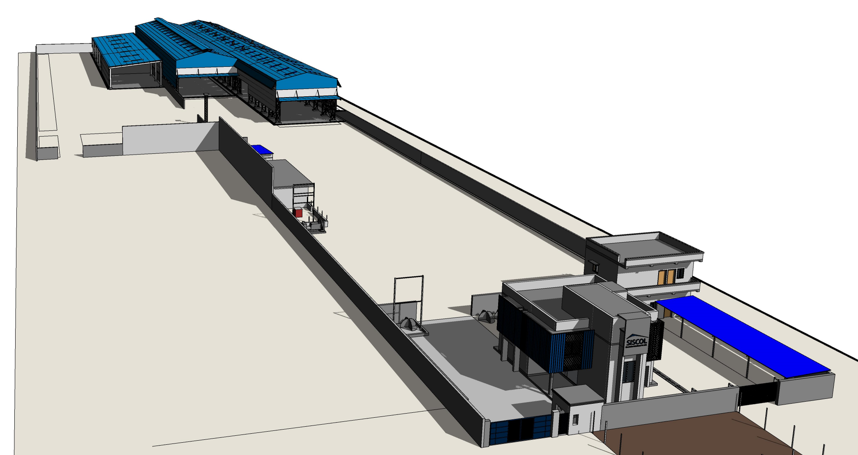
SISCOL UNIT 3
5 Acres (20,234 sq.m)

Slide 13
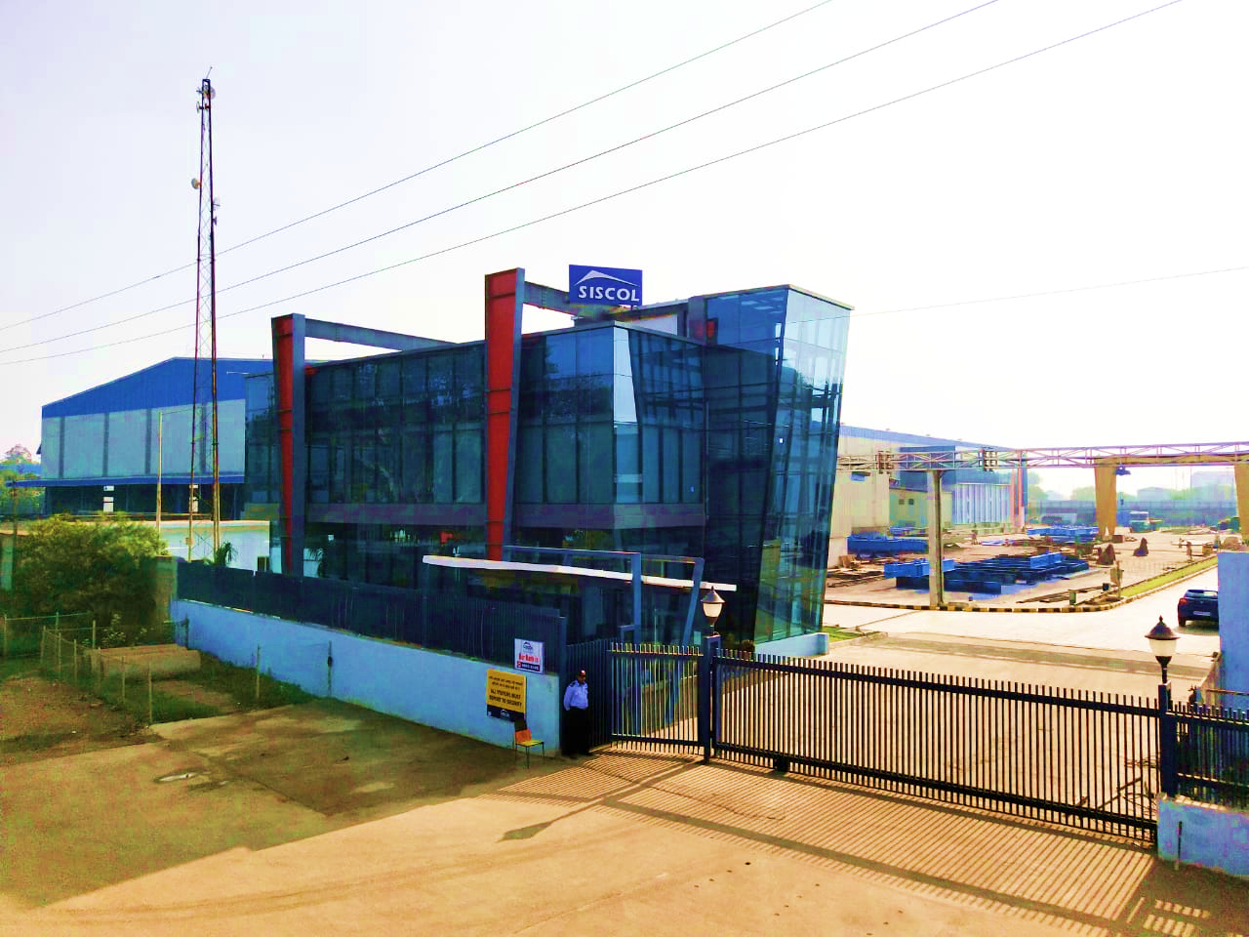
Unit-1

Slide 14
SISCOL's Customers

Slide 15
CAPABILITIES DEVELOPED BY SISCOL
DETAILED ENGINEERING FOR OVER 6000 MT OF STEEL STRUCTURES
STRUCTURAL FABRICATION USING PLATES UPTO 150MM THICK.
ONE OF THE FEW COMPANIES IN THE COUNTRY WITH THIS CAPABILITY
MANUFACTURED COMPLEX STRUCTURES FOR BHOLA AND DWARKA CONVENTION CENTRE
SISCOL IS NOW ACKNOWLEDGED AS ONE OF THE LEADING STEEL FABRICATOR IN THE COUNTRY
SISCOL, DUE TO THEIR CAPABILITY OF “ON TIME, ON COST, TO THE SPECIFICATION” IS IN A POSITION TO DEMAND PREMIUM PRICE
DEVELOPED ERECTION CAPABILITIES AND BAGGED FIRST ERECTION ORDER FOR A HOSPITAL BUILDING IN ROURKELLA

Slide 16
COMPLETED/ONGOING PROJECTS
S. NO. | CUSTOMER | TYPE OF STRUCTURE | LOCATION | TOTAL TONNAGE
1 | RKD-TRIBENI (JV) | OPEN WEB GIRDER | JHARSUGUDA | 775
2 | RKD 2 | OPEN WEB GIRDER | JHARSUGUDA | 73
3 | LNT MHPS 1 | POWER PLANT STRUCTURE | GHATMPUR | 482
4 | LNT MHPS 2 | POWER PLANT STRUCTURE | GHATMPUR | 1105
5 | LNT MHPS 3 | POWER PLANT STRUCTURE | GHATMPUR | 150
6 | R. K. INFRA CORP | COMPOSITE GIRDER | LATEHAR | 332
7 | INDURE | POWER PLANT STRUCTURE | DIFFERENT LOCATIONS | 2000
8 | ISGEC 1 | BOILER STRUCTURE | INDONESIA | 1006
9 | ISGEC 2 | BOILER STRUCTURE | INDONESIA | 196
10 | ISGEC 3 | BOILER STRUCTURE | GORAKHPUR | 320
11 | FABTECH 1 | PIPE RACK STRUCTURE | ASSAM | 433
12 | FABTECH 2 | PIPE RACK STRUCTURE | ASSAM | 78
13 | TPL | POWER PLANT STRUCTURE | RAMAGUNDAM | 6000
14 | L&T TIIC | COMPOSITE GIRDER | BEED | 600
15 | L&T TIIC | COMPOSITE GIRDER | SILIGURI | 630
16 | BLK | MULTI STOREY BUILDING | BANGALORE | 4500
17 | GDCL | COMPOSITE GIRDER | KHARSIA | 154
18 | GDCL | COMPOSITE GIRDER | RENUKOOT | 2188

Slide 17
19 | L&T B&F | HEAVY STEEL STRUCTURE | DWARKA CONVENTIONAL CENTER | 6604
20 | L&T B&F | HEAVY STEEL STRUCTURE | DWARKA CONVENTIONAL CENTER | 4000
21 | GLOBAL INFRA (SHAPPORJI PALLONJI) | POWER PLANT STRUCTURE | BANGLADESH | 1200
22 | NCC 1 | COMPOSITE GIRDER | PUNE METRO | 1140
23 | NCC 2 | COMPOSITE GIRDER | PUNE METRO | 1427
24 | KNRCL 1 | COMPOSITE GIRDER | PASSIGHAT (Arunanchal) | 750
25 | KNRCL 2 | COMPOSITE GIRDER | KARNATAKA | 1890
26 | FAIRMOUNT SHREM HOTEL | MULTI STOREY HOTEL | MUMBAI | 4000
27 | L&T HCI - DFCC | OPEN WEB GIRDER | FARIDABAD | 936
28 | L&T HCI - EDFC | OPEN WEB GIRDER | MEERUT | 1645
29 | JMC | COMPOSITE GIRDER | MUMBAI | 708
30 | L&T HE 1 | REFINERY STRUCTURE | HMEL BHATINDA | 1768
31 | L&T HE 2 | REFINERY STRUCTURE | HMEL BHATINDA | 482
32 | URC | MULTI STOREY BUILDING | ROURKELA | 504
33 | TECHNIP | POWER PLANT STRUCTURE | SINDHRI & BARAUNI | 2400
34 | THYSSENKRUP | POWER PLANT STRUCTURE | NORTH KARANPURA | 1750

Slide 18
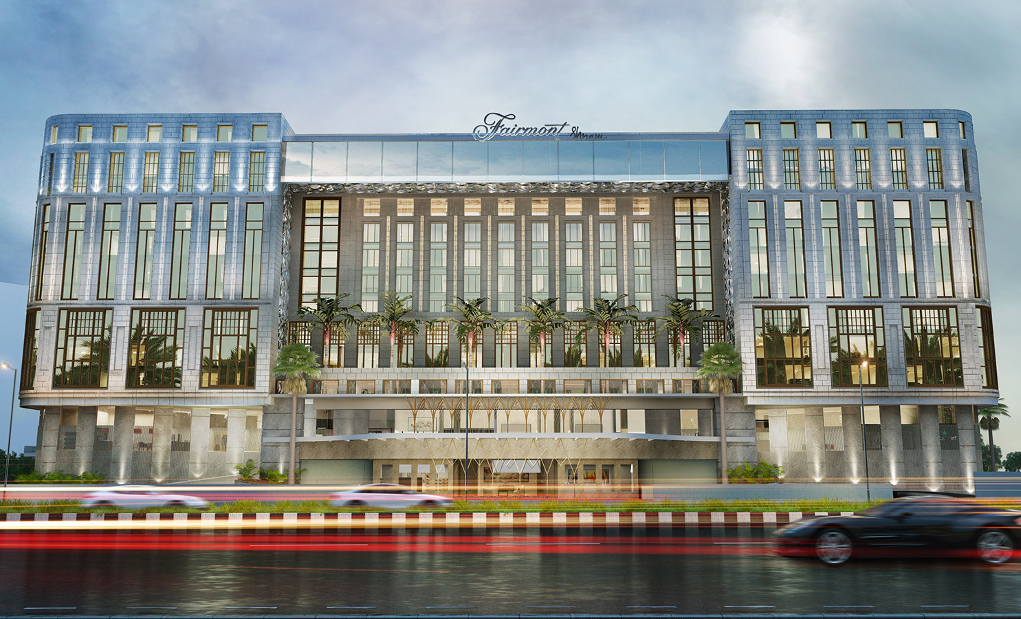
FAIRMOUNT - SHREM HOTEL, MUMBAI

Slide 19
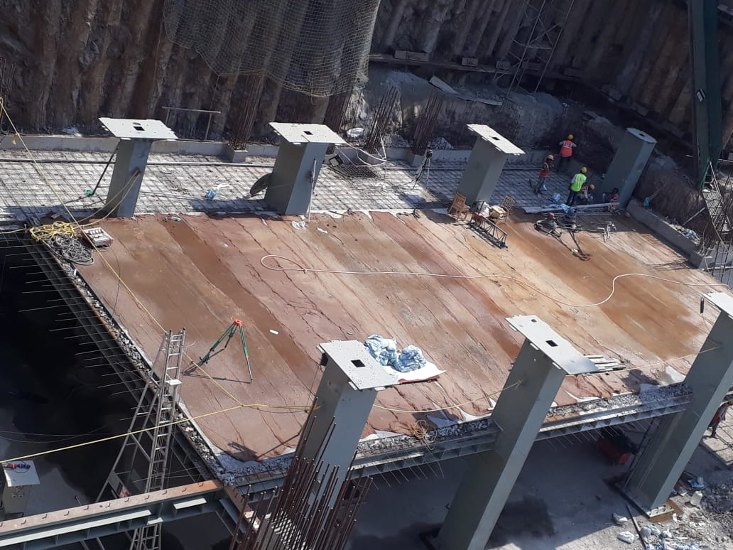
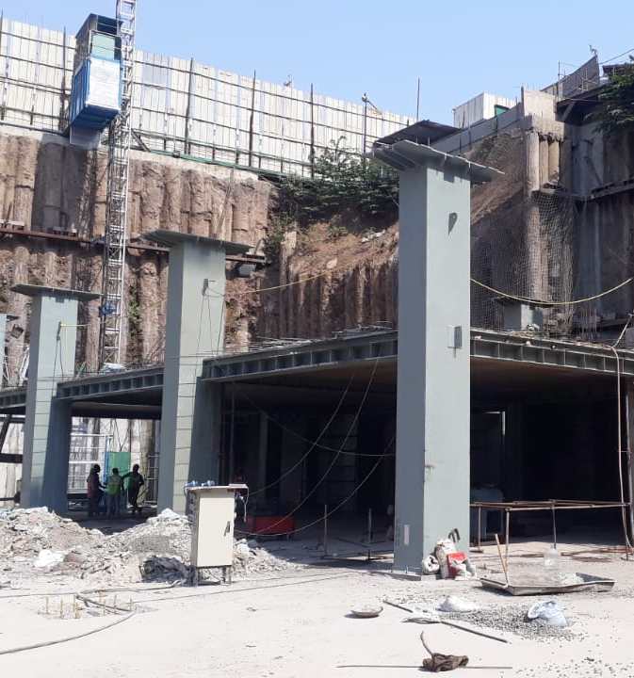

Slide 20
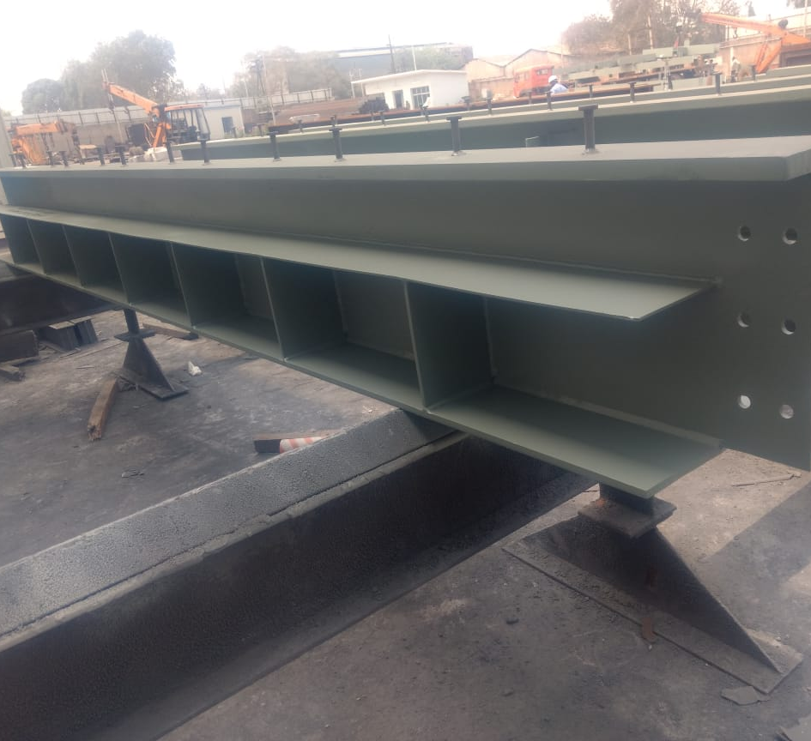
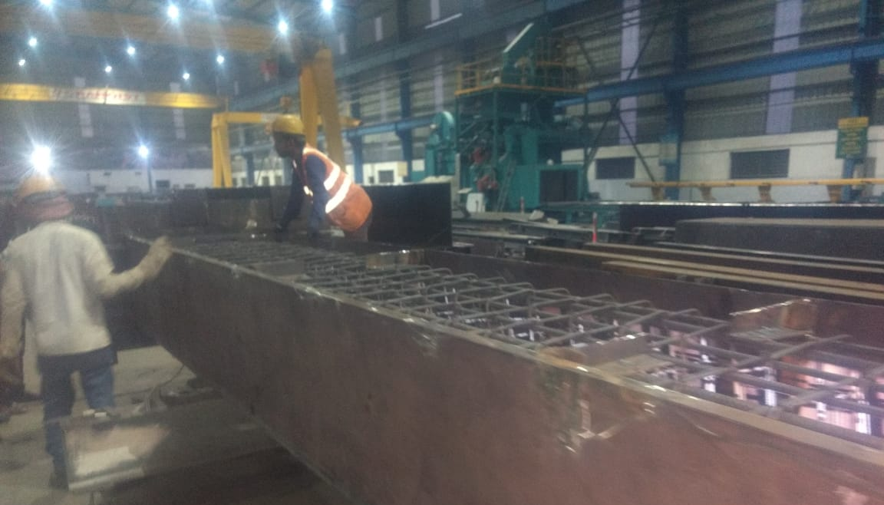

Slide 21
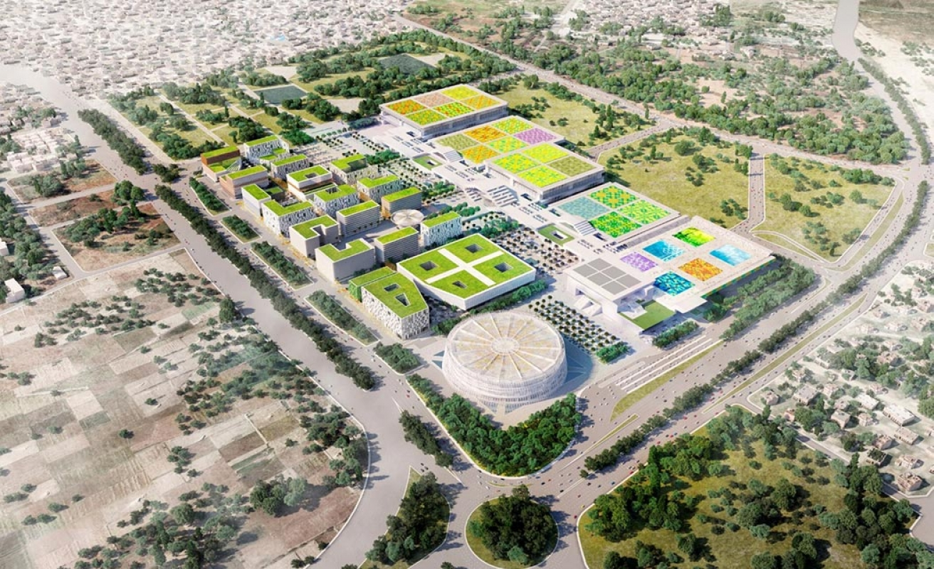
DWARKA CONVENTION CENTRE, DELHI

Slide 22
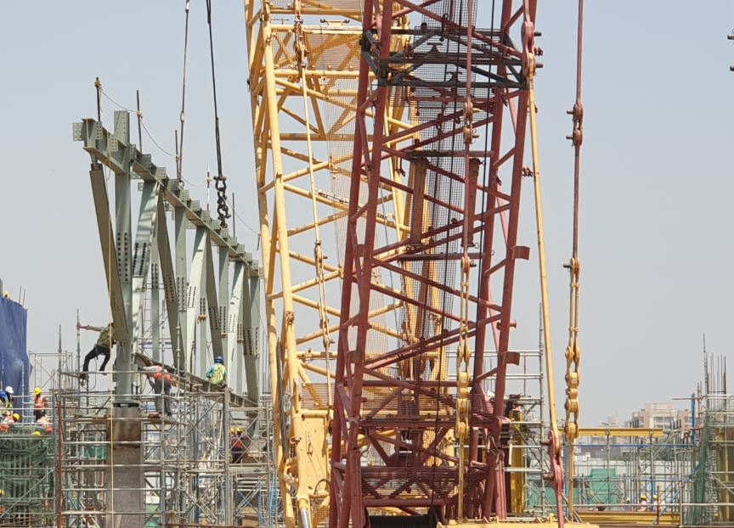
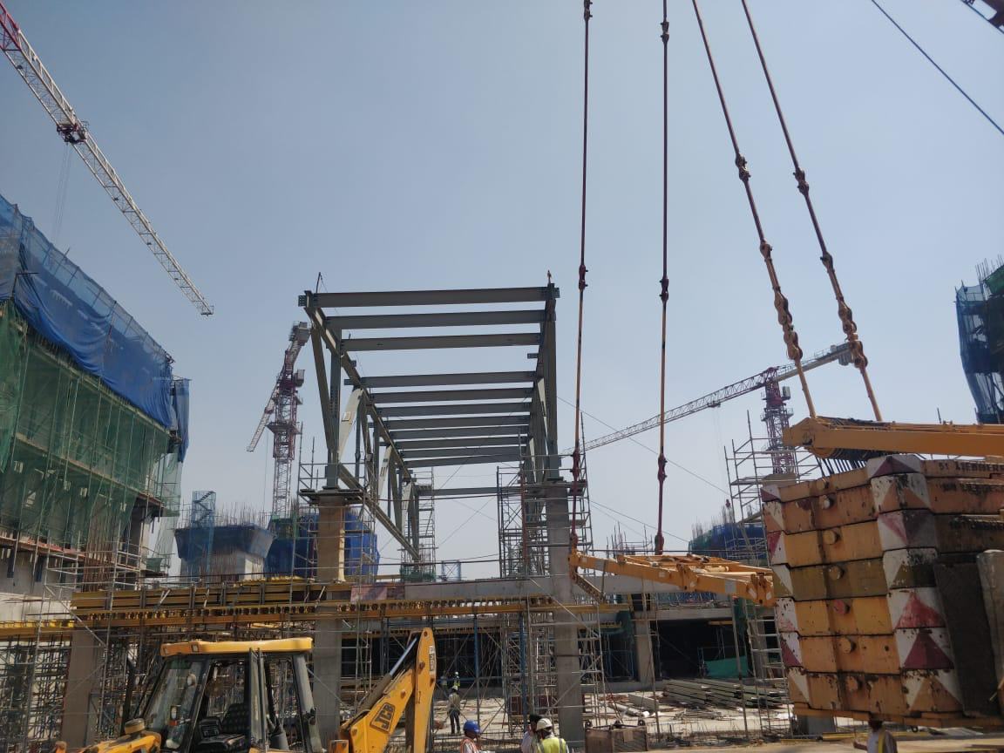

Slide 23
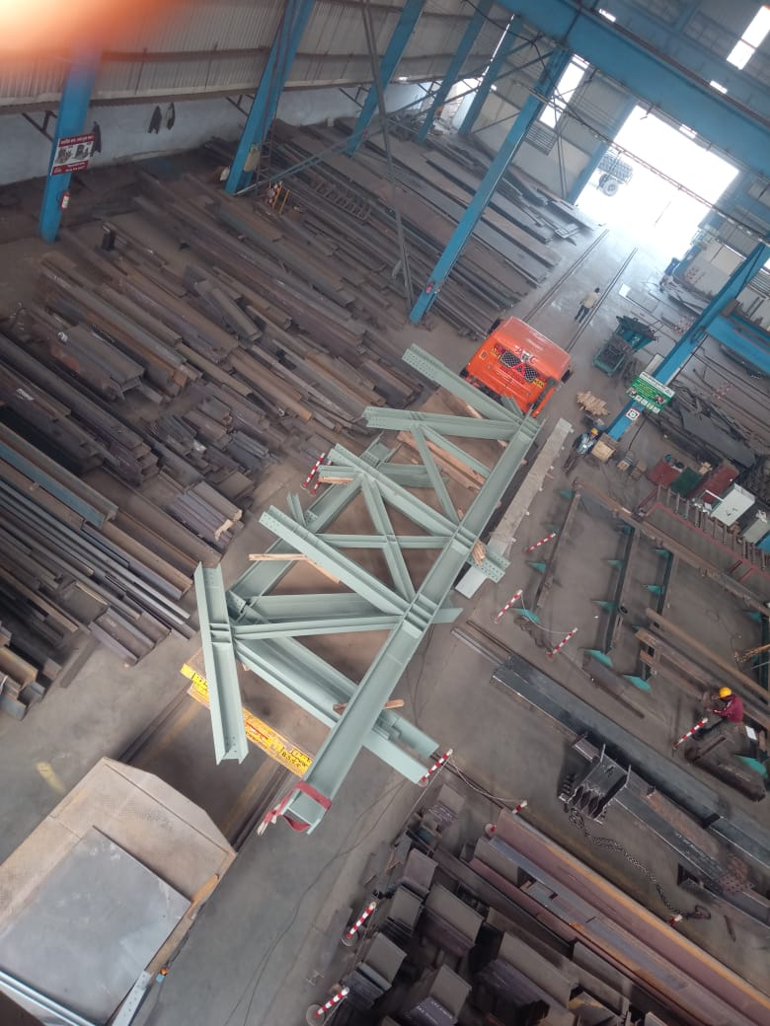
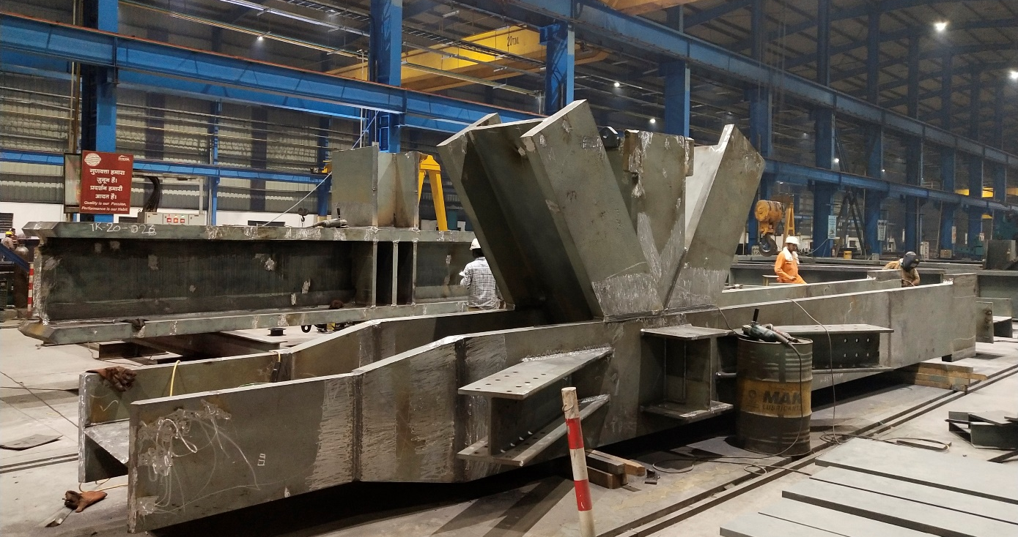

Slide 24
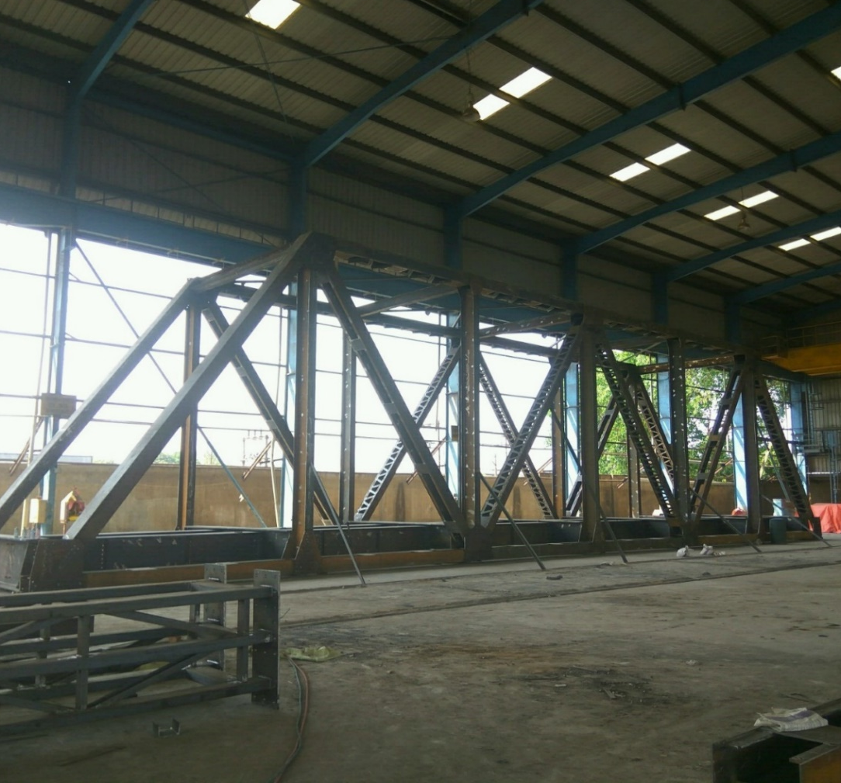
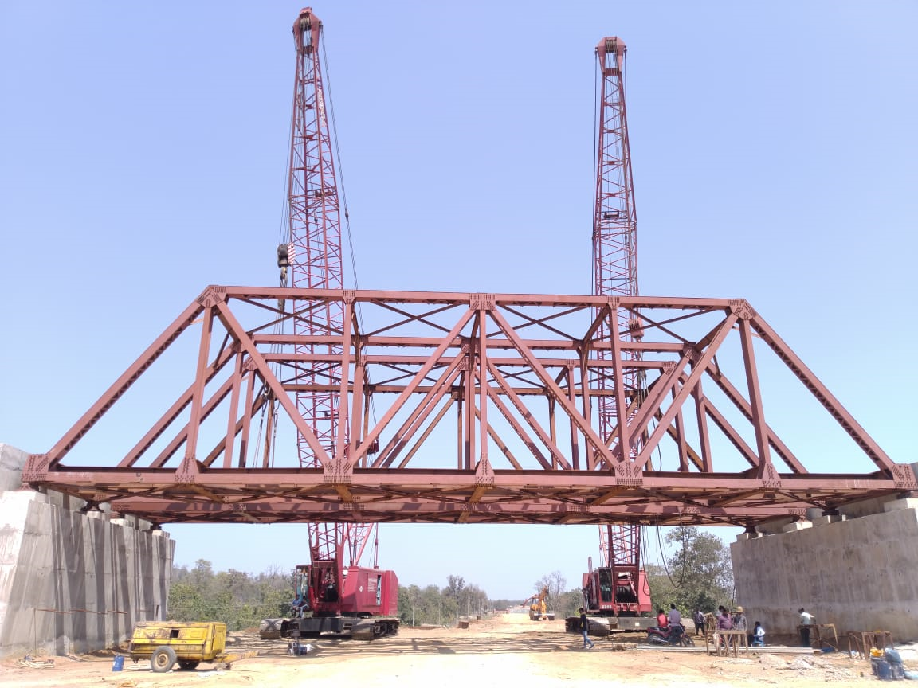
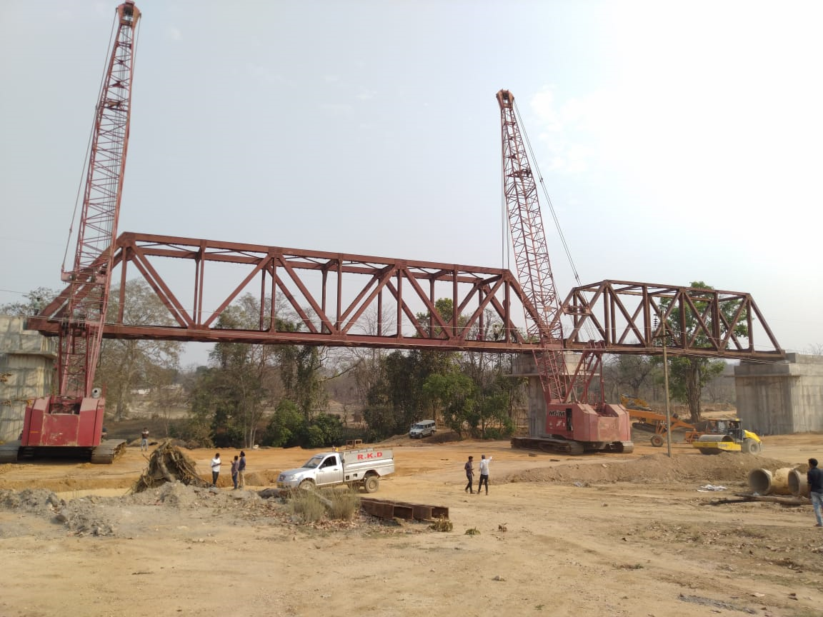
CLIENT: RKD-TRIBENI JV – OPEN WEB BRIDGE GIRDER, JHARSUGUDA, ORRISA

Slide 25
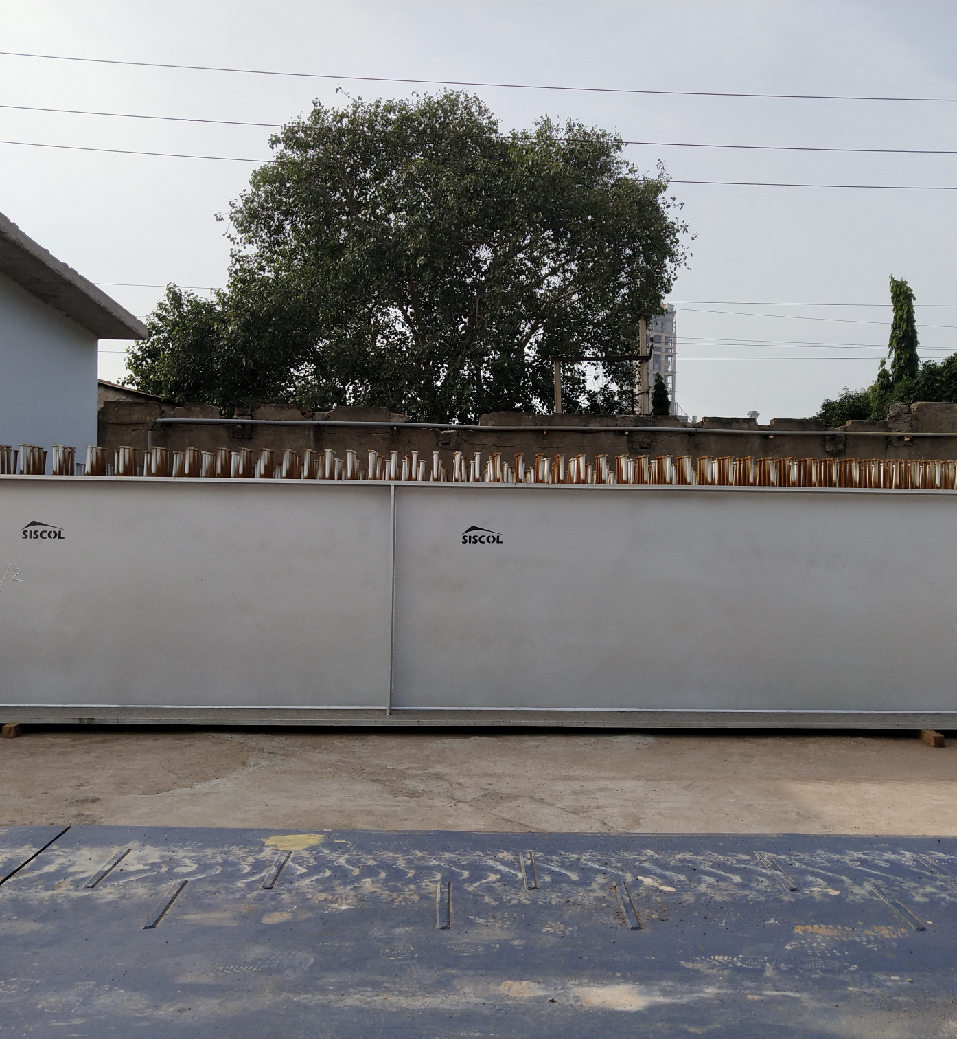
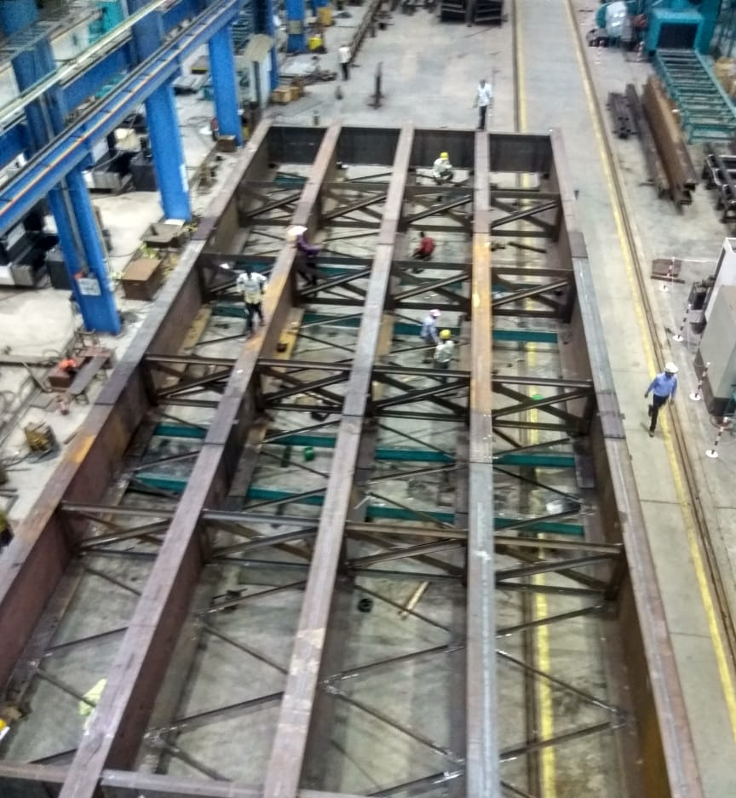
CLIENT: RK INFRA – COMPOSITE GIRDER, LATEHAR, JHARKHAND

Slide 26
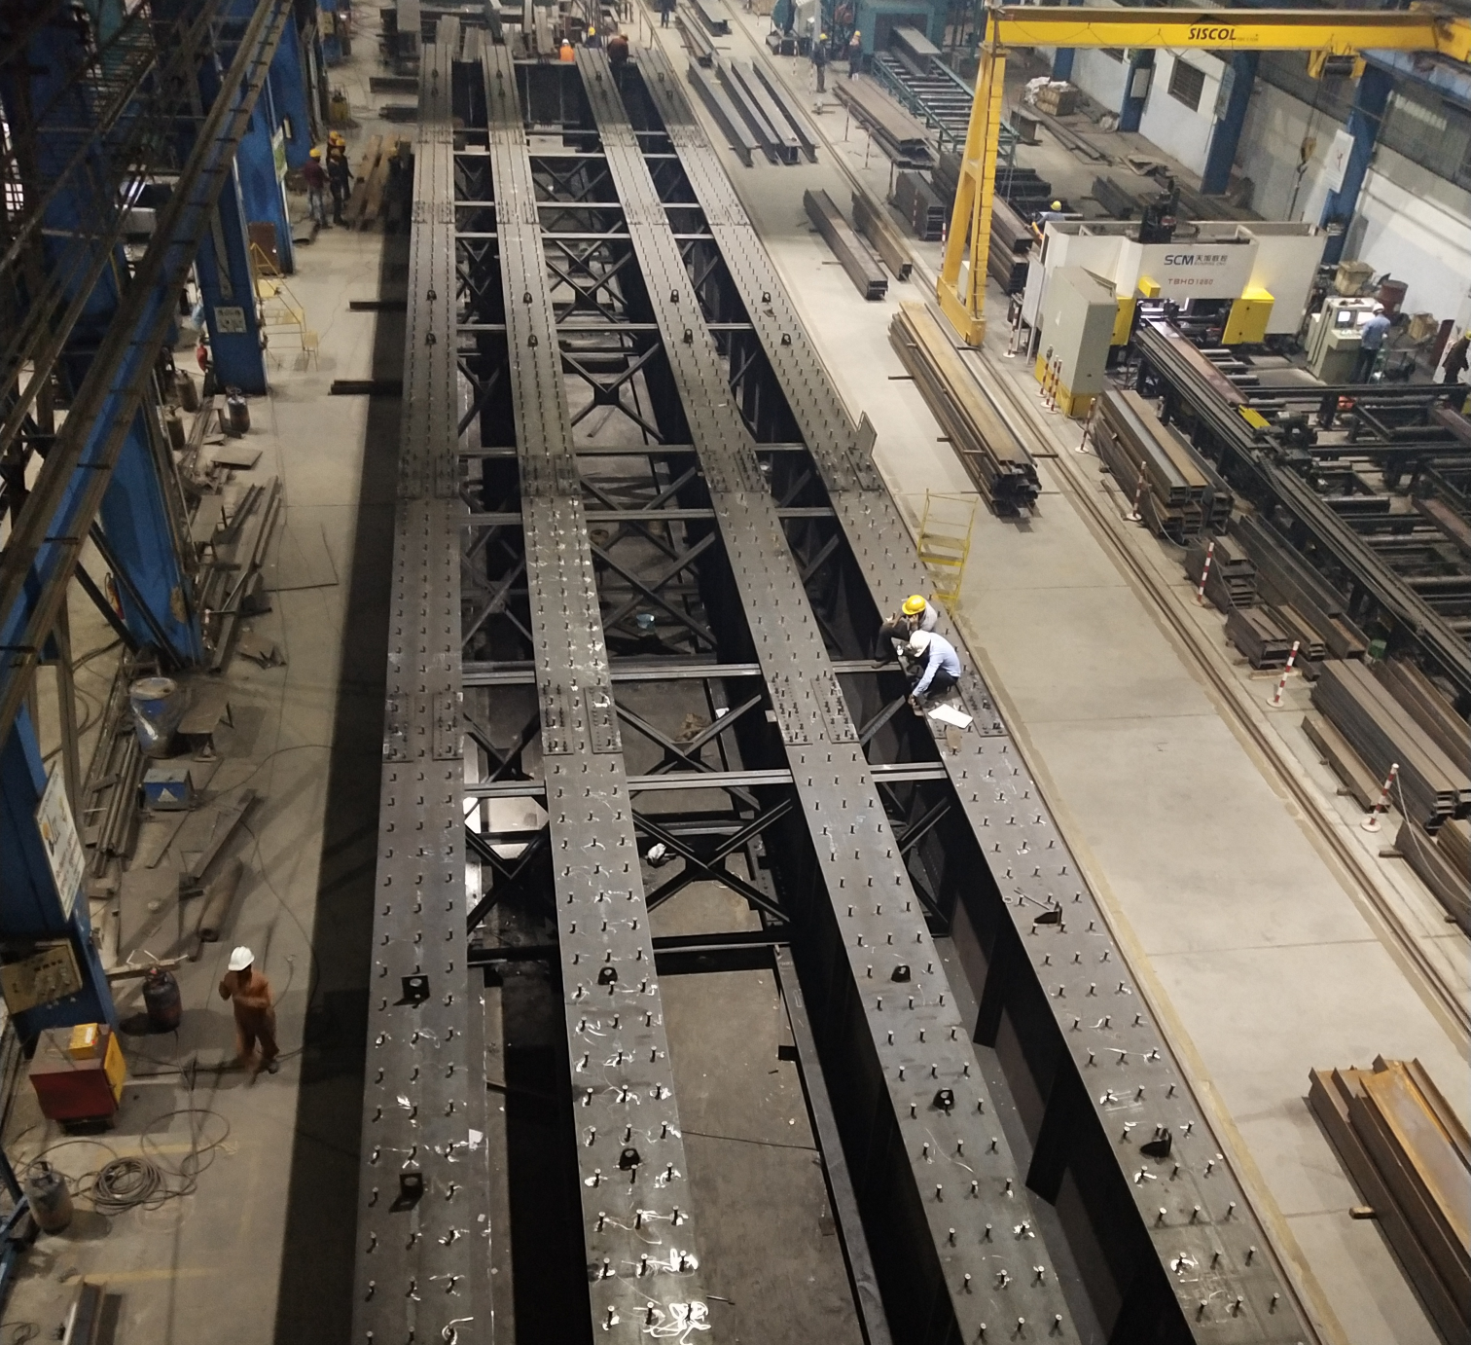
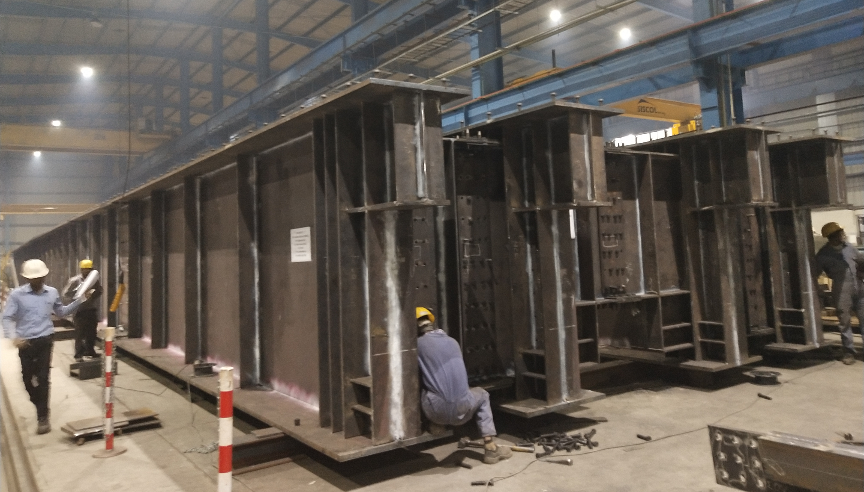
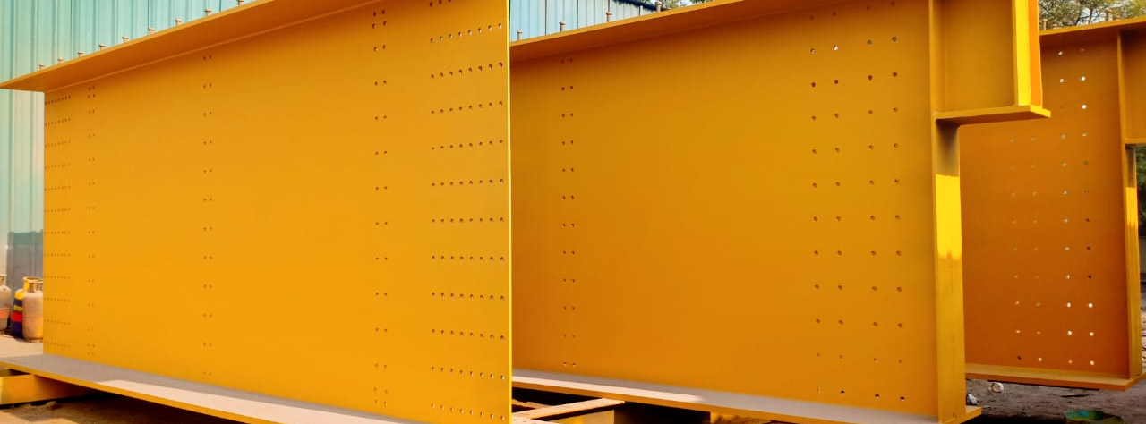
CLIENT: NCC – COMPOSITE BRIDGE GIRDERS - PUNE METRO BRIDGES

Slide 27
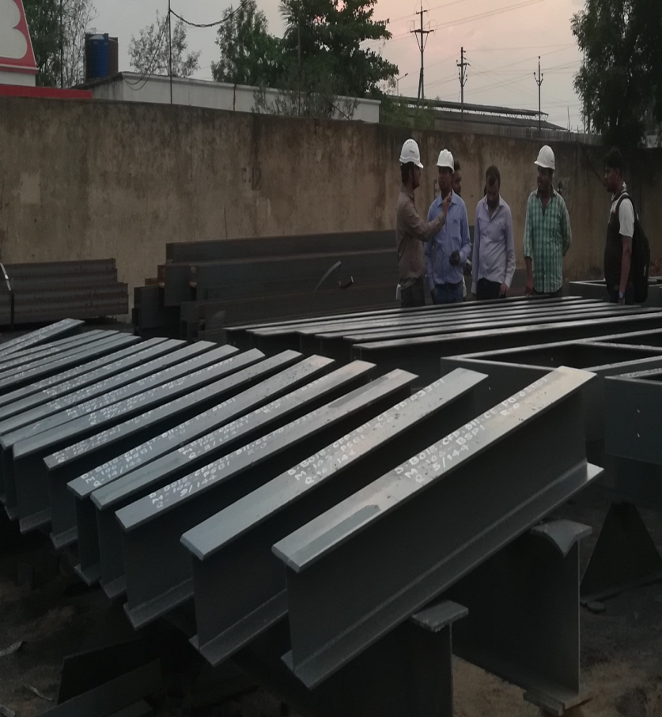
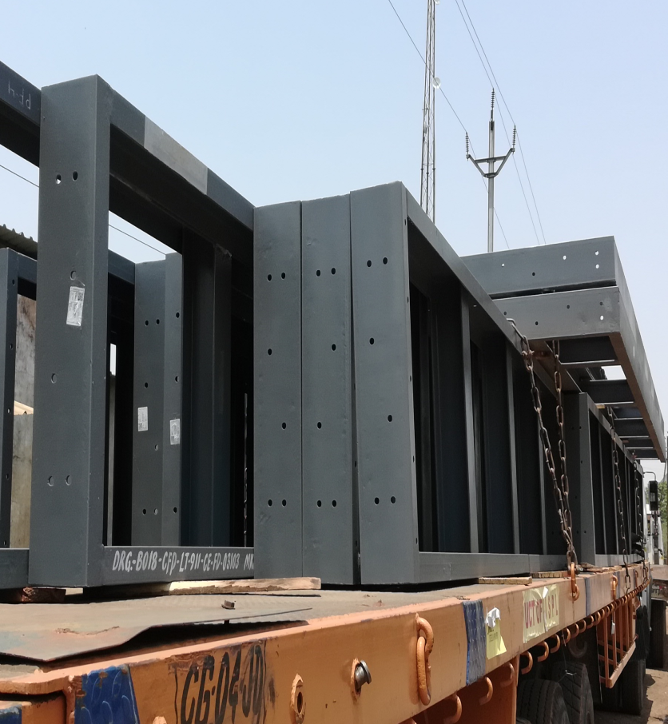
CLIENT: L&T HYDROCARBON, BHATINDA REFINERY

Slide 28
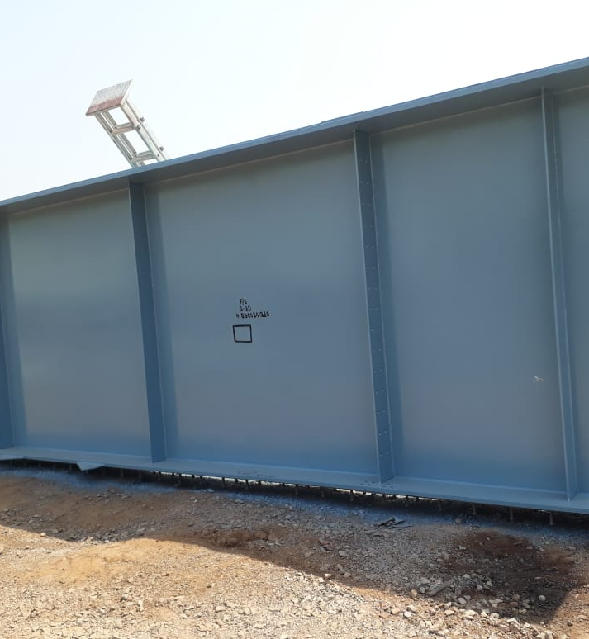
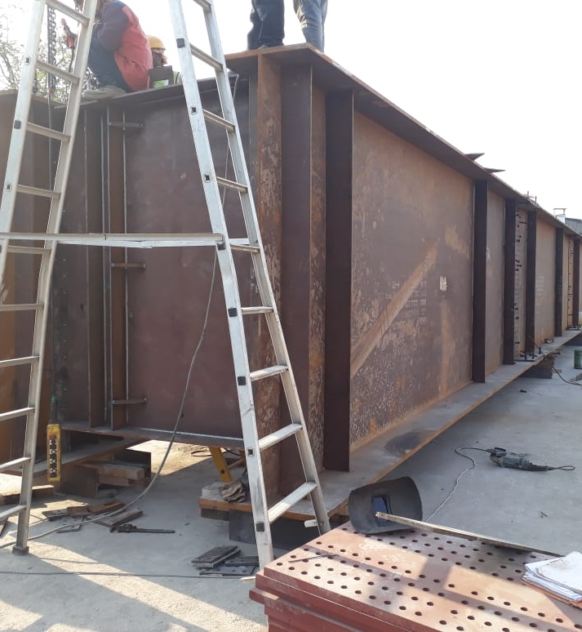
CLIENT: KNRCL – COMPOSITE BRIDGE GIRDER , PASIGHAT, ARUNACHAL PRADESH

Slide 29
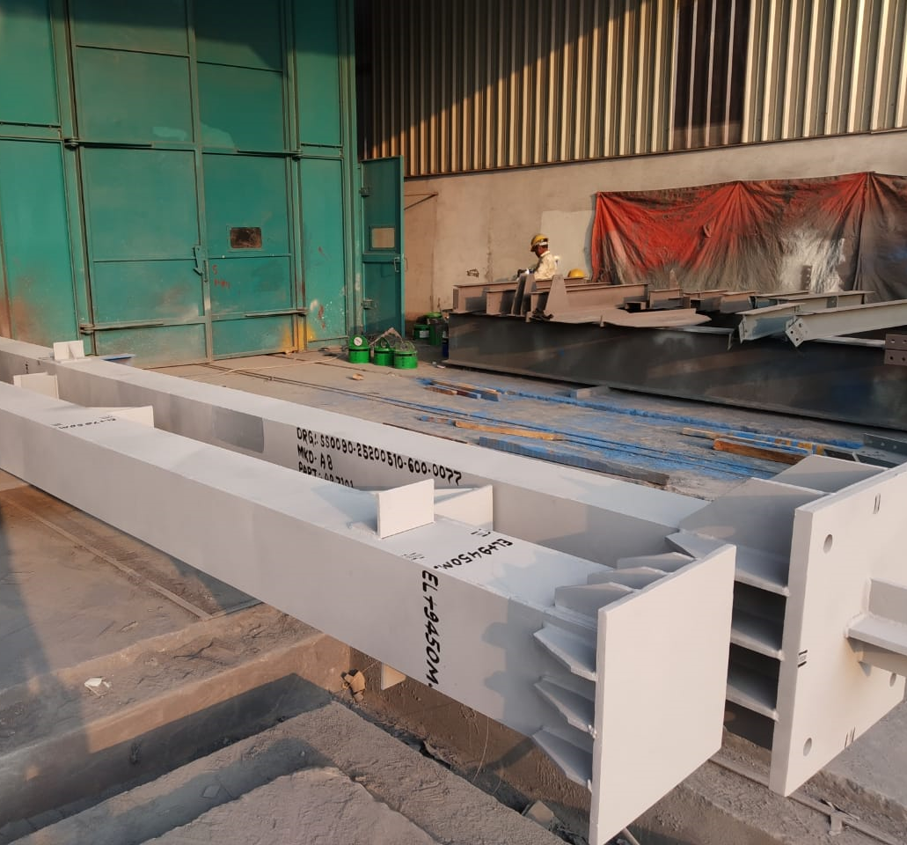
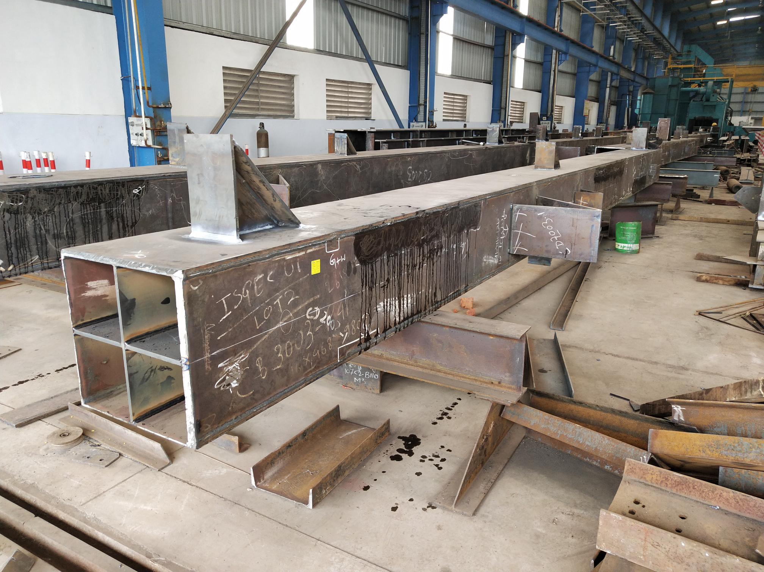
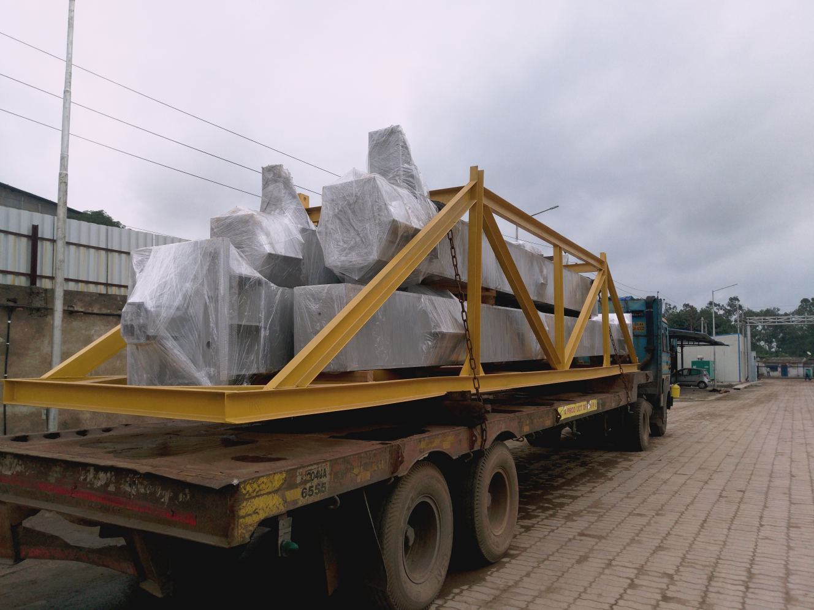
Client: ISGEC – INDUSTRIAL STRUCTURE, INDONESIA

Slide 30
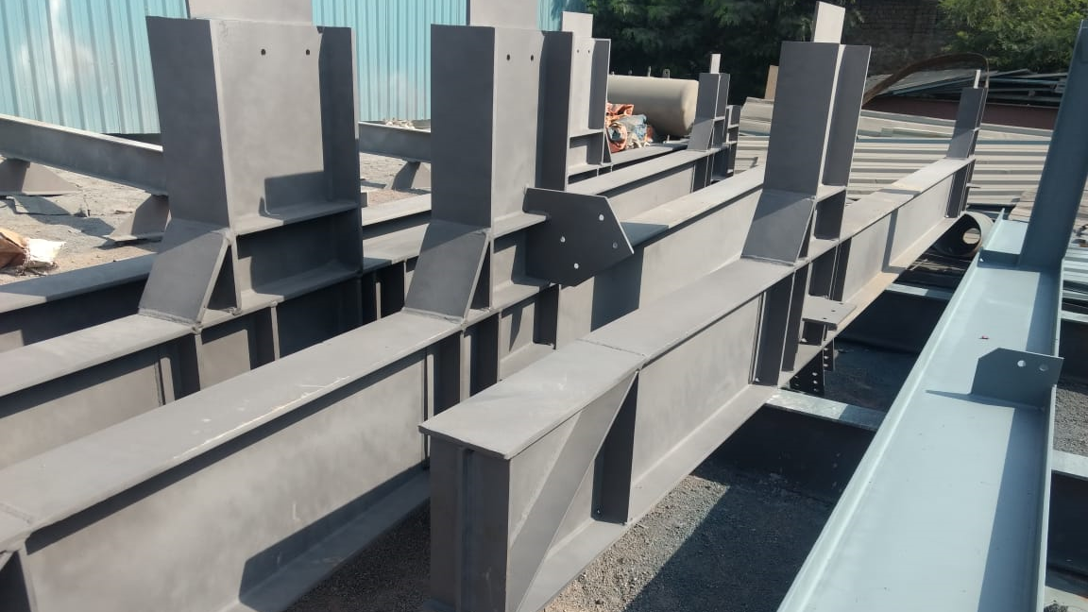
Client: Fabtech – IOCL REFINERY, ASSAM

Slide 31
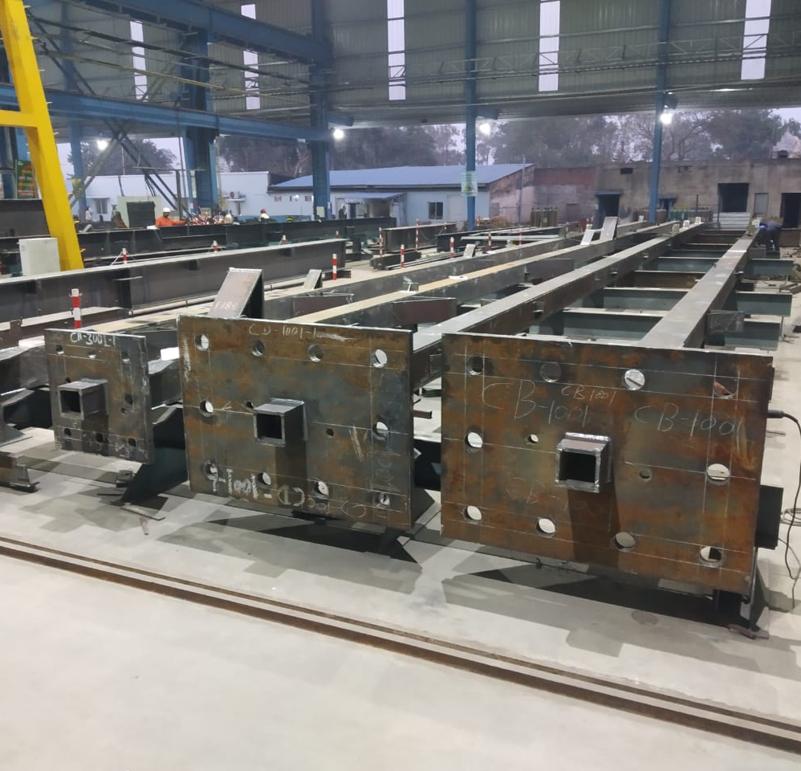
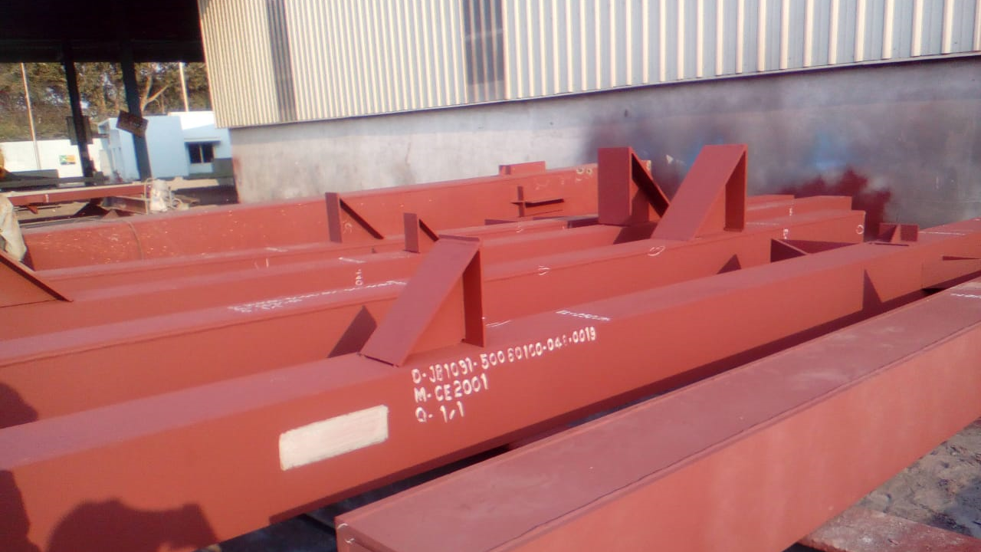
Client: ISGEC - UP State Sugar Mill

Slide 32
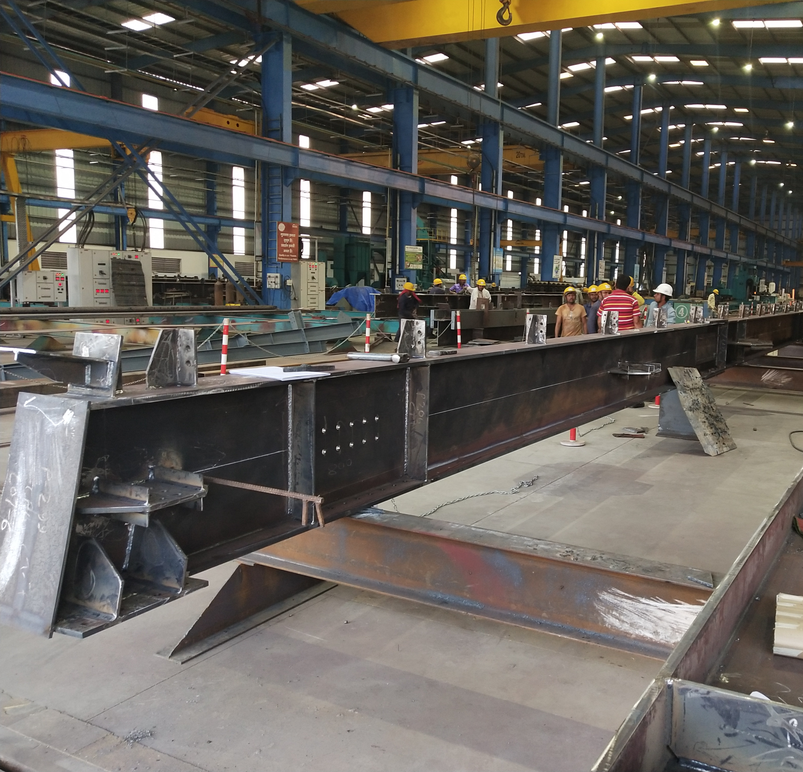
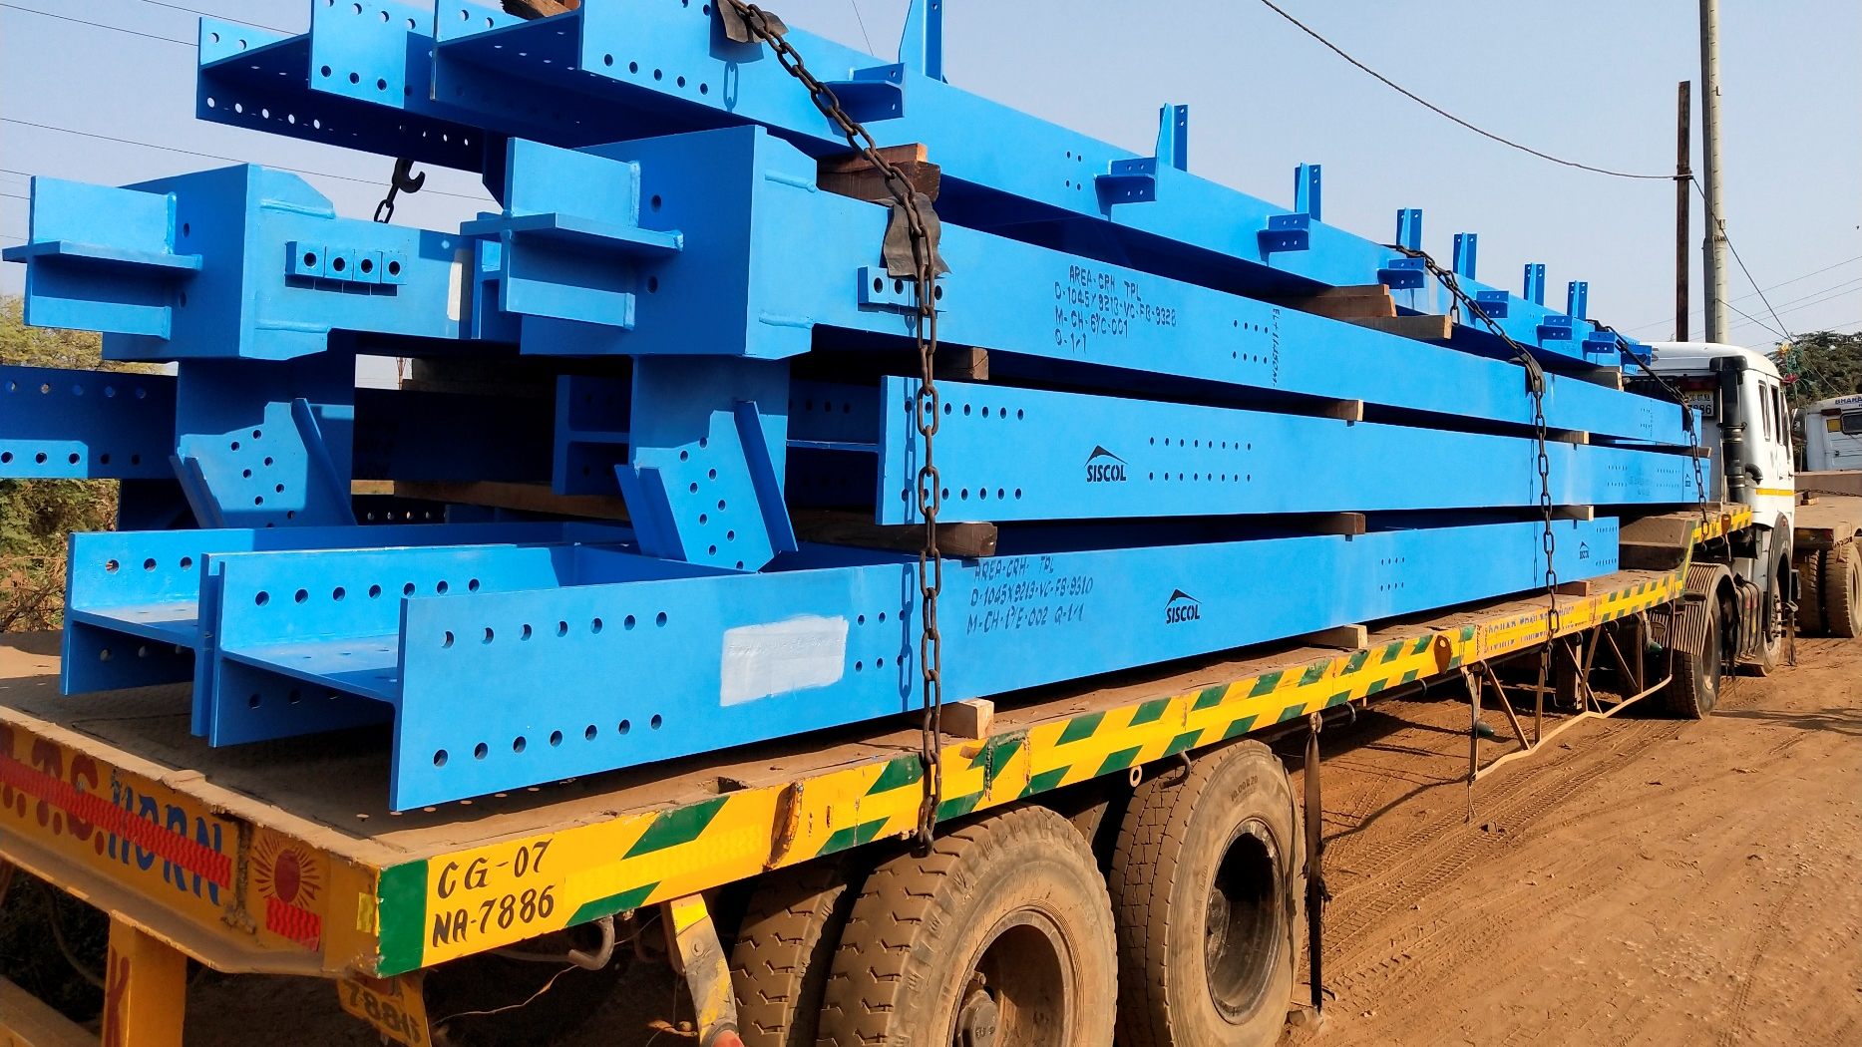
Client: TPL – NTPC RAMAGUNDAM POWER PLANT, TELANGANA

Slide 33
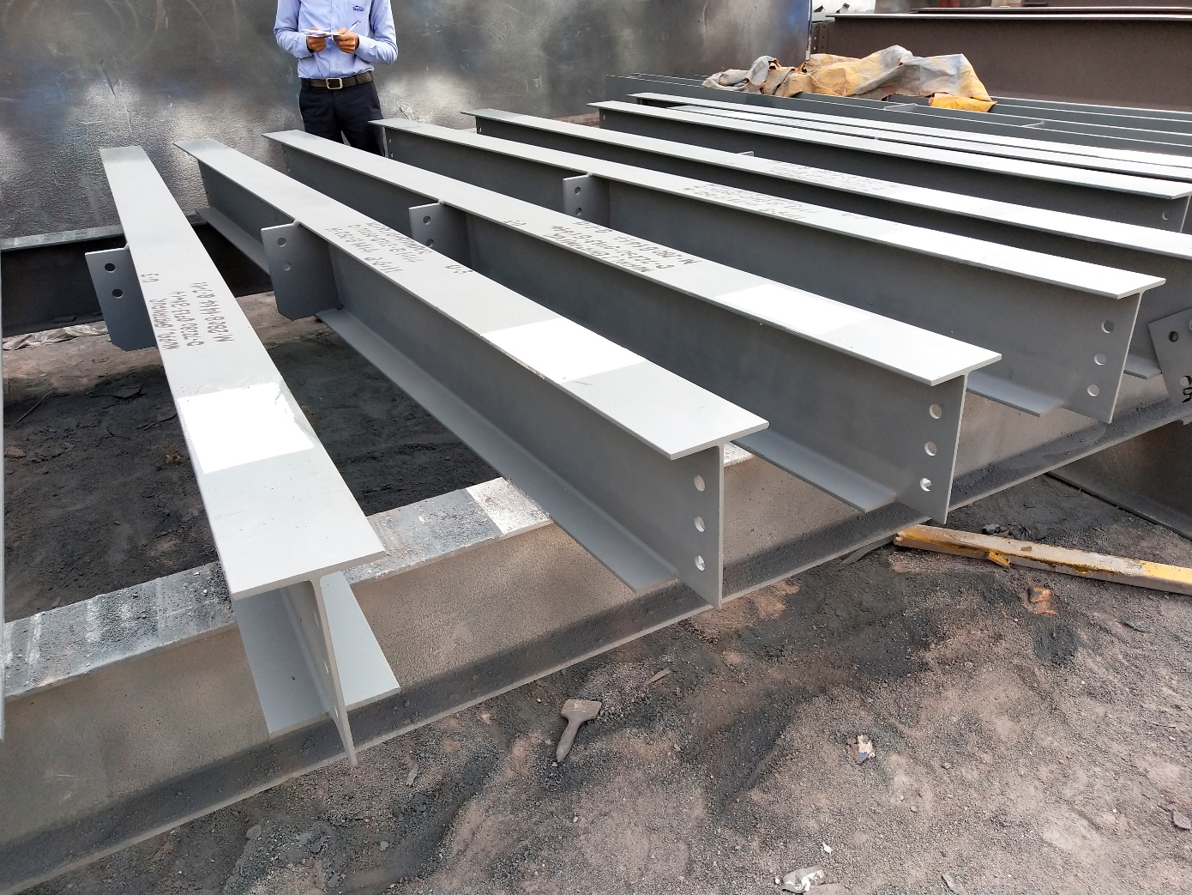
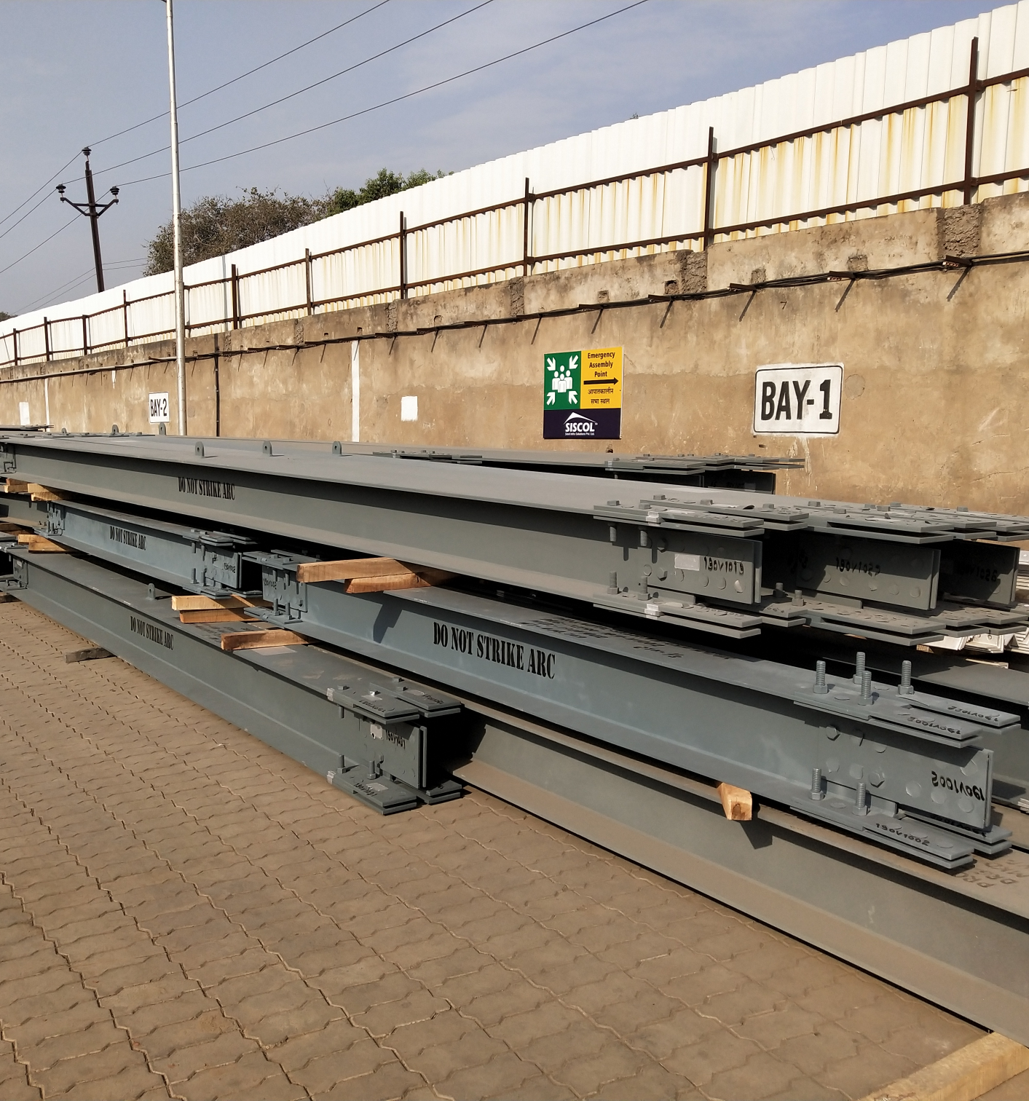
Client: L&T MHPS – GHATAMPUR THERMAL POWER PROJECT, U.P

Slide 34
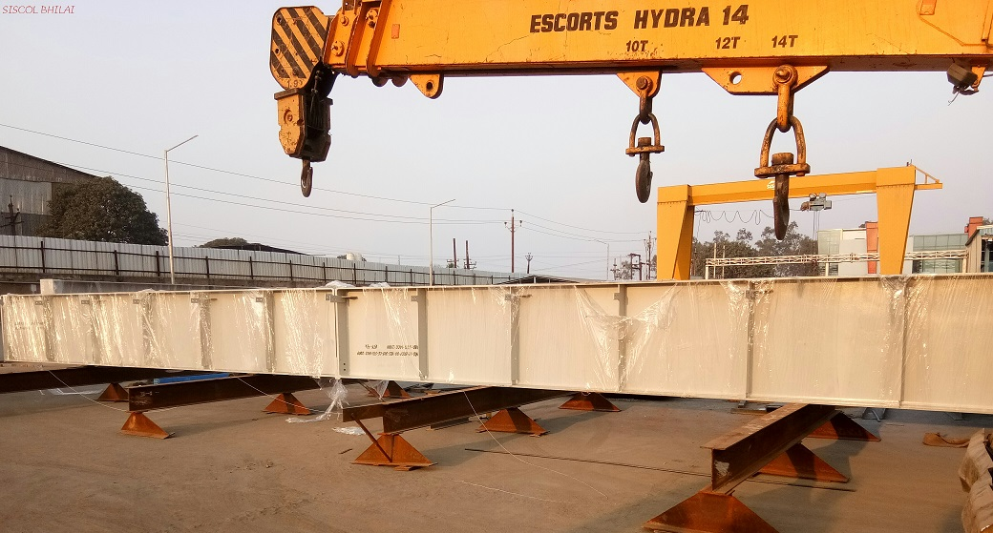
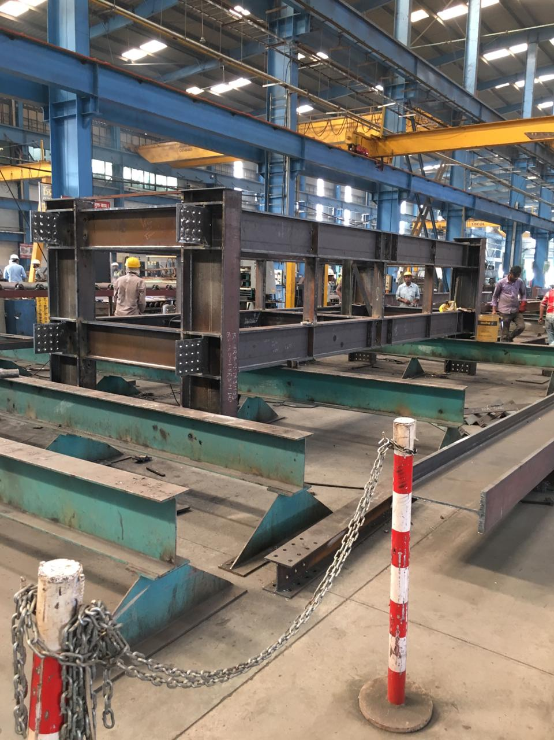
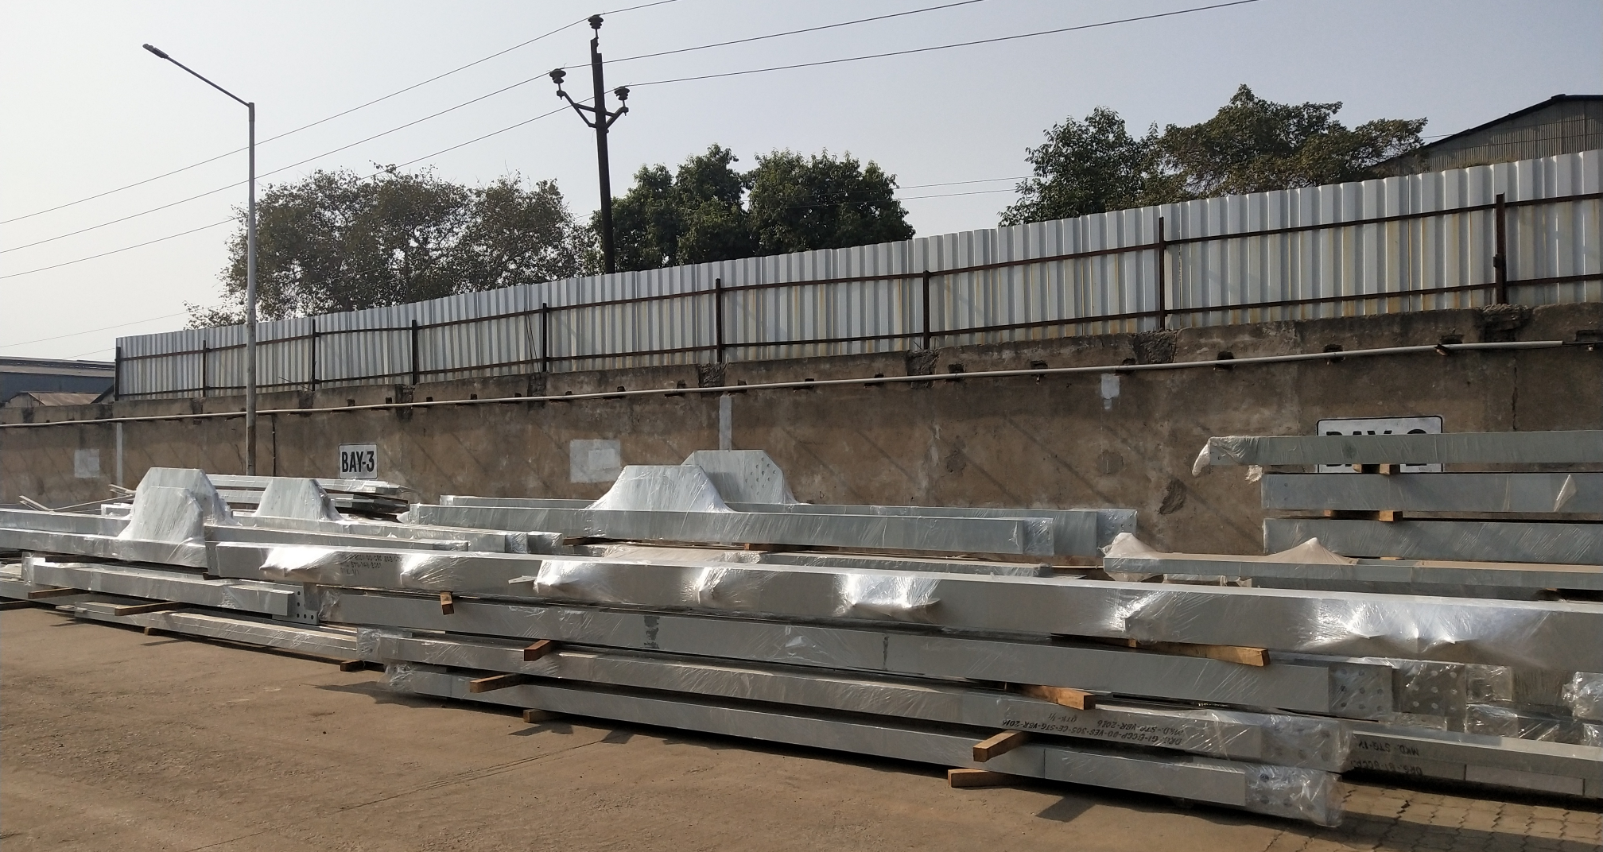
CLIENT: SHAPOORJI & PALLONGI, POWER PLANT – BHOLA, BANGLADESH

Slide 35
Thank you

