Slide 1
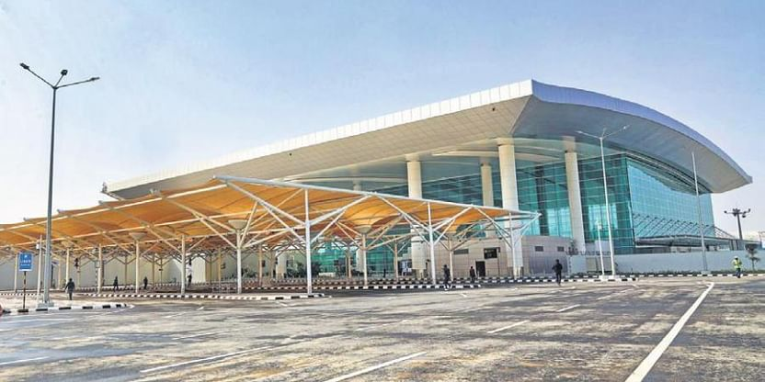
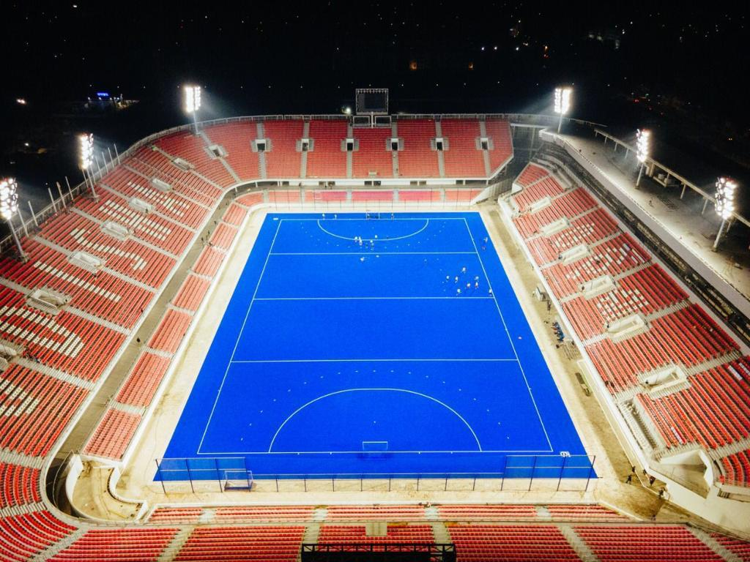

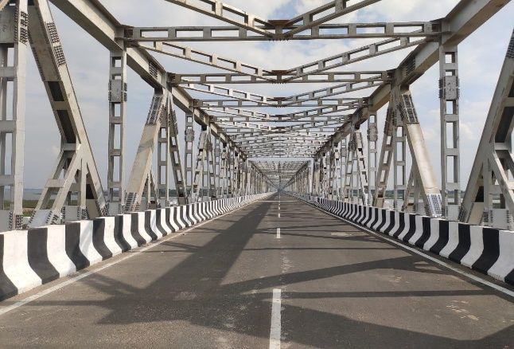
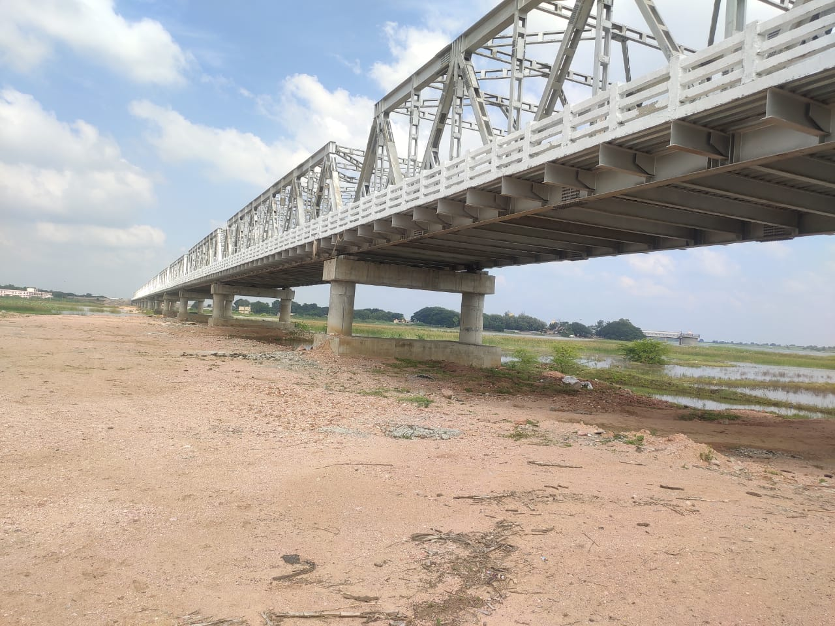

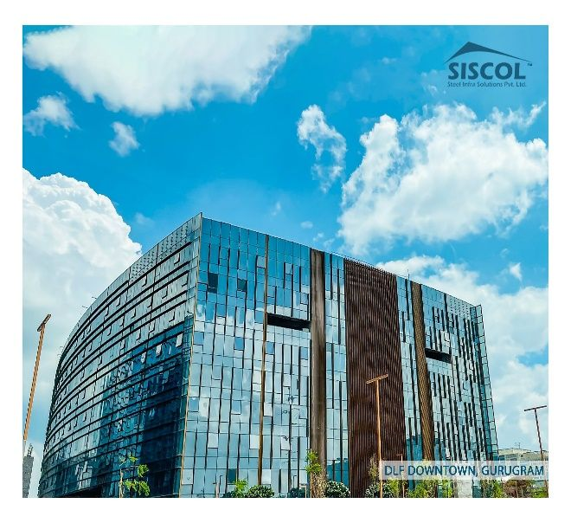
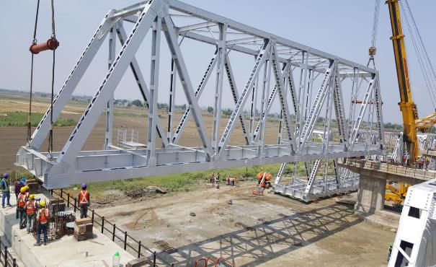
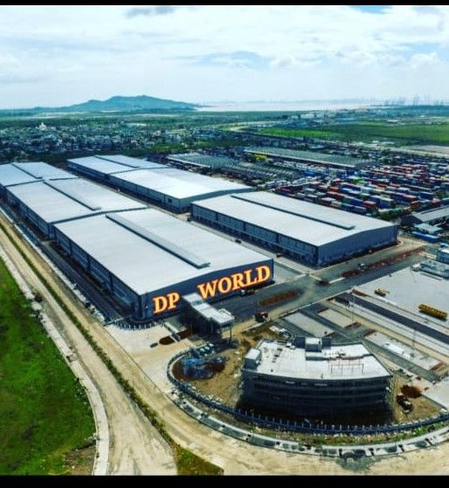
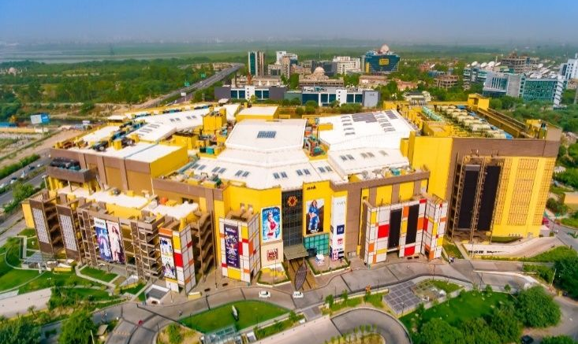


Slide 2
TABLE OF CONTENTS
ABOUT US
ENGINEERING AND TECHNOLOGY DRIVEN ACTIVITIES
FACTORIES AND AUTOMATION
QUALITY ASSURANCE
PROJECT MANAGEMENT AND ERECTION ACTIVITIES

Slide 3
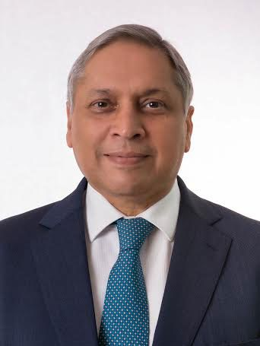
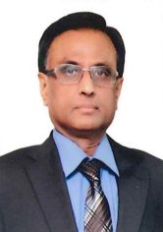
SISCOL PROMOTERS
RAVI UPPAL
CHAIRMAN & MD
40 years of experience in the Electromechanical & Infrastructure industry. Distinguished record of setting up new businesses & turn around of existing businesses. Worked with ABB, Siemens, L&T, Volvo, JSPL
Ex- Managing Director, JSPL; Ex- Director, Larsen & Toubro; Ex- Whole Time Director, ABB; Ex- Country Head- Volvo
K . RAJAGOPAL
DIRECTOR – FINANCE
Over 35 years experience of distinguished service in manufacturing industry. Worked with ABB Switzerland, ABB India, JSPL
Ex- CFO, JSPL; Ex-CFO, ABB Switzerland

Slide 4
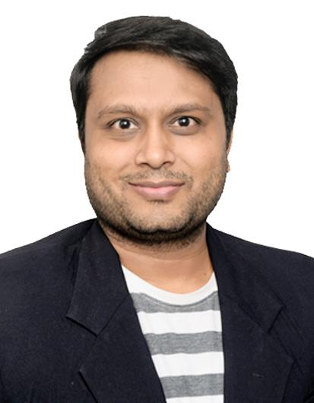
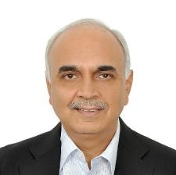
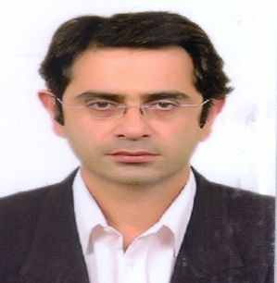
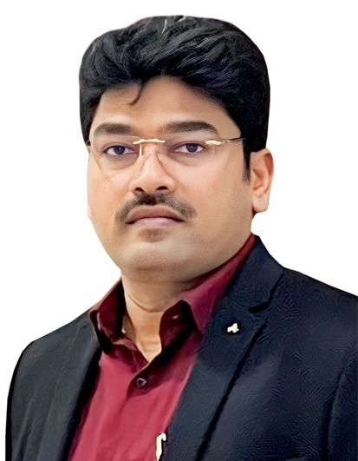
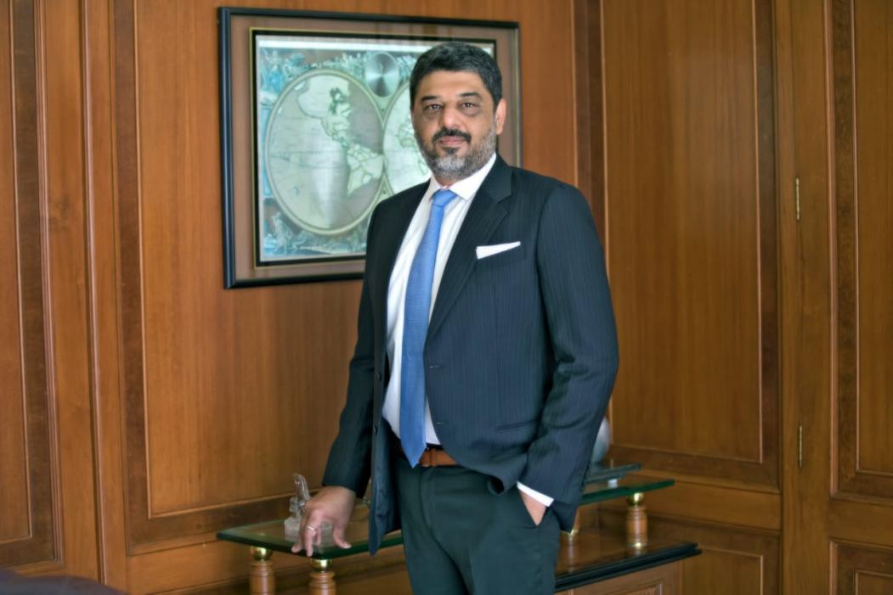
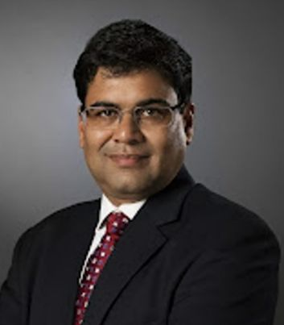
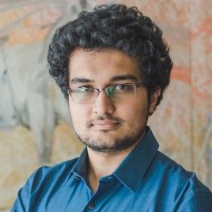
SISCOL’s INVESTORS
M K Ventures
Siddharth Shah
Wharton Engineers & Developers Pvt . Ltd.
Ranjan Sharma
Surin Holdings LLP
Aman
choudhari
Steel Infra Solutions Pvt . Ltd.
Y S Reddy
J H Parabia (Transport) Pvt. Ltd.
Zarksis J Parabia
Flute Aura Entreprises p Ltd
Rajesh Laddha
Meridian Investments
Siddarth Pai

Slide 5

SISCOL Organizational Structure
Chairman & MD
Ravi Uppal
Director
Finance
Head BD &
Marketing
Director
(BU Head)
Operations
BU Head
Engineering
BU Head
Installation
Head HR
BU Head
PEB
Quality
Assurance
K Rajagopal
TBA
Ramachandra
Hegde
AVP
Anuj Mathur
GM
Amit Gupta
AVP
Mukesh Rao
AVP
Y S Reddy
K S L Rao
VP
Company Secretory / Compliance Officer
Mkt. Sales
Vadodara
Operations
Hyderabad
Operations
Corp &
Plant HR
Finance
Company Secretory
Mkt. Sales
Bhilai
Operations
Bangalore / Bhilai
Projects
-JEWAR
-DIGITAL EDGE
-ITPL
-D2
- C5
-KEC
Finance
Head
Mitesh Jain
Mohit Kabra
Site HR
Client Relationship
Sreekrishna
EHS &
ESG
Client Relationship
Production
Production
Production
Corp
Liaison
F & A
Suraj Agrawal
R P Padhy
Audit
Chennai
Costing
Madasamy
(Chennai)
PPC
PPC
PPC
Vinayagam
Admin
F & A
Infra
Development
Taxation
PMG
PMG
PMG
IT
Security
TBA
Shailesh (Mumbai)
Maintenance
Maintenance
Maintenance
Audit
Painting
Painting
Painting
Treasury
Procurement/ Eximp
(Delhi)
Procurement
Procurement
Contracts & Commercial
Stores
Stores
Stores
Internal Process Control
Logistics
Logistics
Logistics
Field Service
IT
Date : 01.02.2025

Slide 6
MANAGEMENT TEAM –Operations
Y S Reddy
COO & Director (Operations)
Over 24 years experience in Structural fabrication industries: Hetat- Singapore, Kirby Building Systems ,Tiger Steel, Octamec.

Slide 7
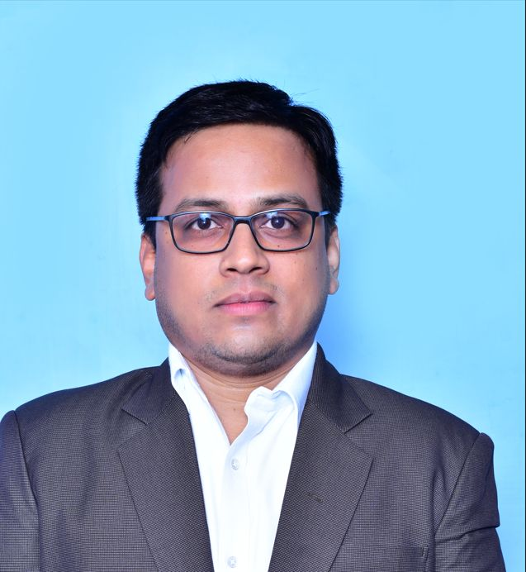
MANAGEMENT TEAM – Quality
MUKESH RAO
Head – Quality
Mr. Mukesh Rao done B.E in Metallurgy Engineering with more than 17 years of experience. Prior to joining us he was associated with JSW Steel, Larsen & Toubro, Welspun Corp Limited.

Slide 8
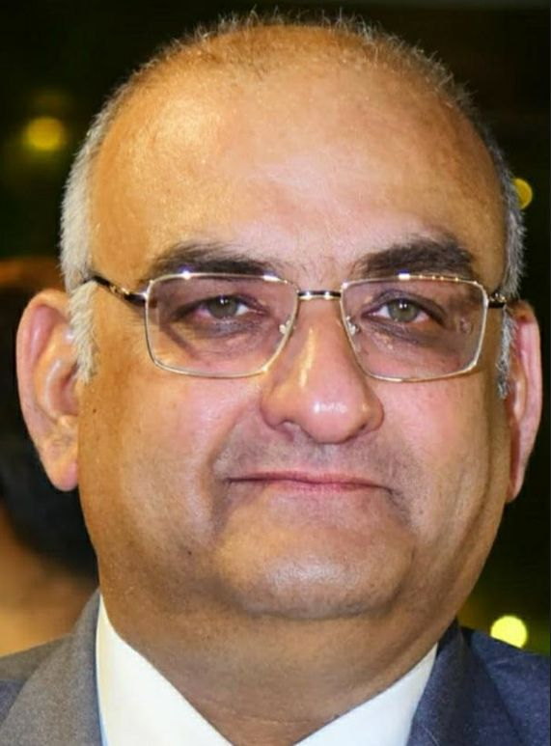
MANAGEMENT TEAM – HR & ERECTION
ANUJ MATHUR
HEAD – HR & ADMIN
K.S.L SRINIVASA RAO
HEAD -ERECTION AND INSTALLATION SERVICES

Slide 9
A new generation company that aims to....
Reset
Reset “VALUE DELIVERY” from fabrication industry
Popularize
Popularize application of steel in construction
Introduce
Introduce efficiency and speedy delivery from fabrication industry
Redefine
Redefine the boundaries between customers and suppliers
Improve
Improve the image of fabrication industry as reliable and dependable
SISCOL as a company “never sleeps” and
is “awake for customer’s needs” at all times

Slide 10
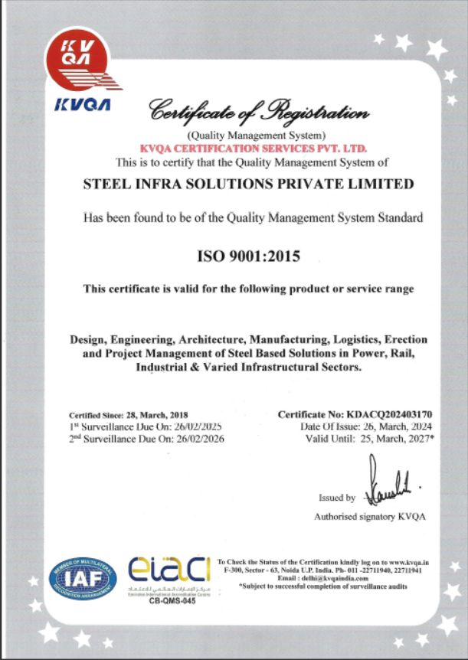
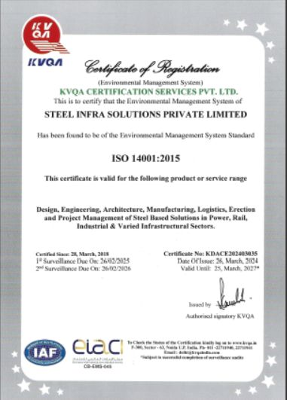
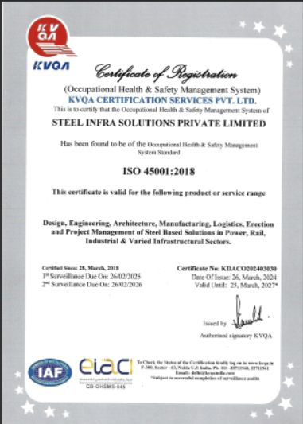
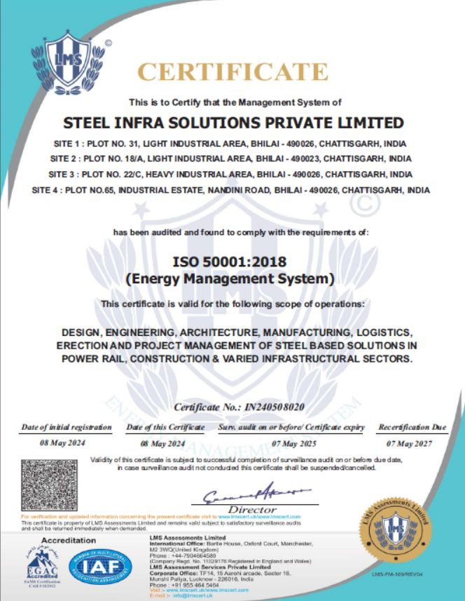

Integrated Management Systems Certifications
ISO 9001:2015
ISO 14001:2015
ISO 45001:2018
ISO 50001:2018
ISO 27001:2022
All units of SISCOL Bhilai are covered under the scope of Integrated Management Systems (IMS)
Occupational Health & Safety Management System upgraded from OHSAS 18001:2007 to ISO 45001:2018
Certification agency conducted annual surveillance in Feb’24 and found “Zero” non-compliances

Slide 11
Integrated Management Systems Certifications
ISO 9001:2015
ISO 14001:2015
ISO 45001:2018
All units of SISCOL Vadodara are covered under the scope of Integrated Management Systems (IMS)
Certification agency conducted annual surveillance in Feb’24 and found “Zero” non-compliances

Slide 12
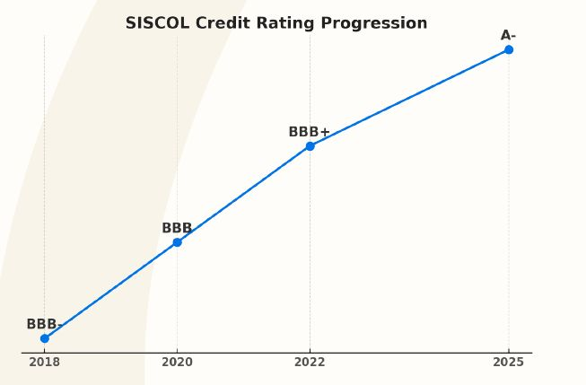
CRISISL Upgrades Rating to A- from BBB+
A proud milestone in 6 years- debt free balance sheet and expanded capacity
Testament to our financial strength and future ready vision

Slide 13
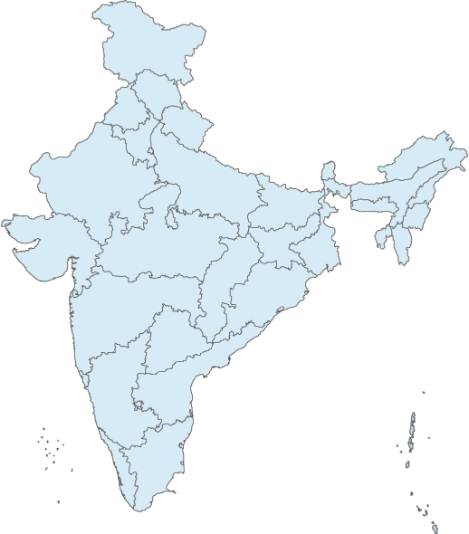


SISCOL's Growing presence
New Delhi
Vadodara
Bhilai
Corporate Office
Mumbai
Hyderabad
Design Office
Manufacturing Units
Bengaluru
Marketing Offices
Chennai
Installation center

Slide 14
USPs of SISCOL
Complete service package to customers from concept to commissioning
Proximity to Raw Material
Proven Design & Engineering capability
High Capital & Labour Productivity
Competitiveness in delivery period
Flawless Quality
End to End Logistics

Slide 15
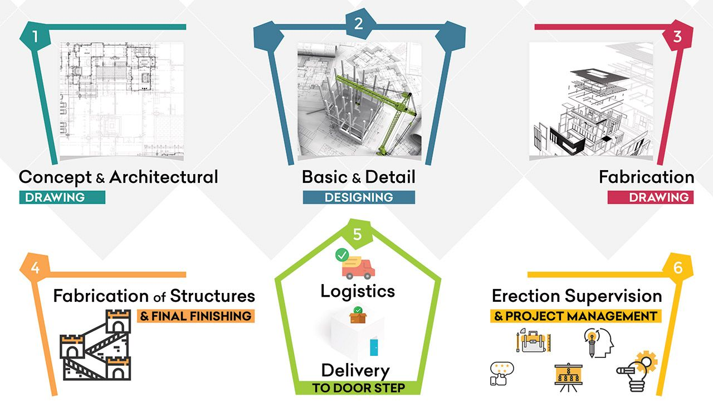
Enterprise offering complete customer solution

Slide 16
CLIENT SEGMENTS
Highrise Buildings & Data Centers
Airports
Sports Stadiums
Bridges, ROBs, Flyovers, Skywalks
PEB
Hotels & Hospitals
Industrial Infrastructure
Metro-rail & Mono-rail
Launching Girders

Slide 17

































SISCOL's Customers

Slide 18
ENGINEERING AND TECHNOLOGY DRIVEN ACTIVITIES

Slide 19
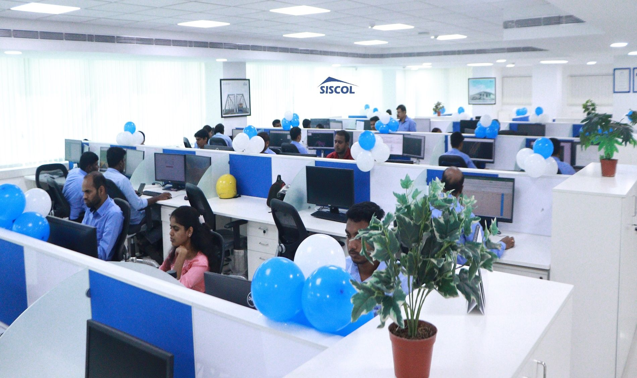





Engineering Services
ANALYSIS AND DESIGN SOFTWARE:
STAAD.PRO, RAM STRUCTURAL SYSTEM, MICROSTRAN, LIMCON, ETABS
DETAILING SOFTWARE:
TEKLA, AUTOCAD
Design Office @ Bengaluru, Chennai, Bhilai, Hyderabad
Team Strength: 75

Slide 20
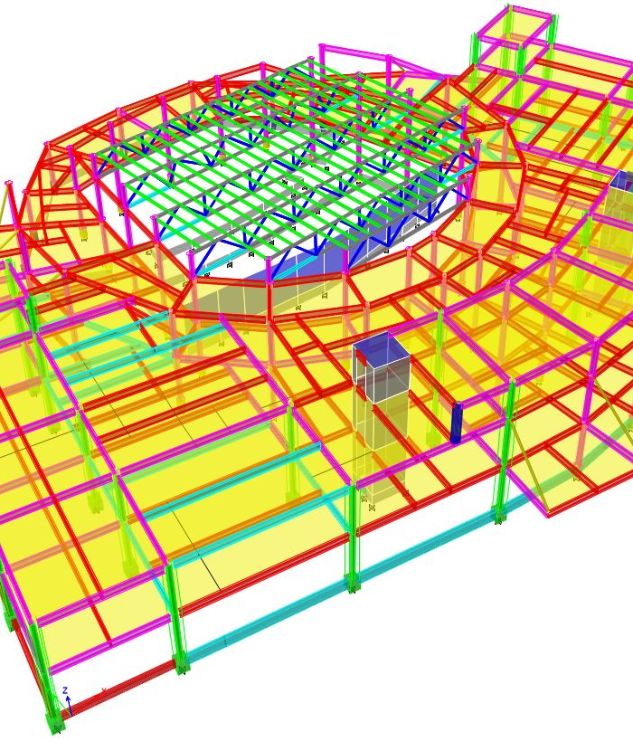
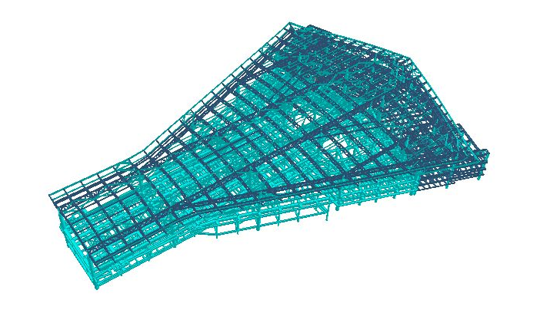
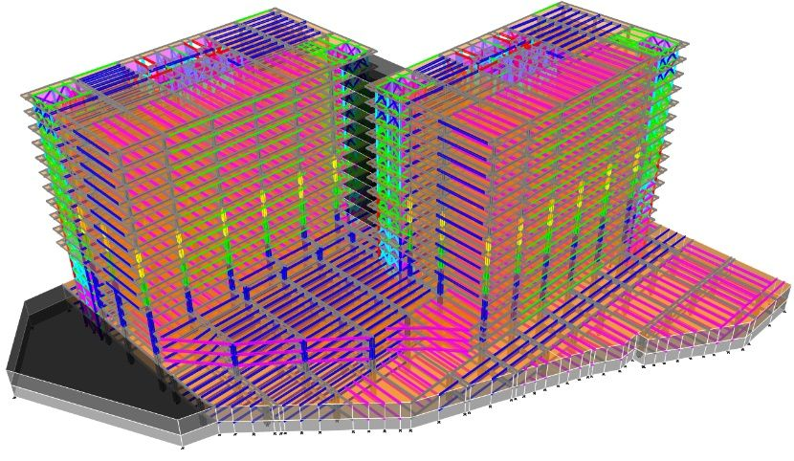

DESIGN ENGINEERING
DESIGN ENGINEERING IS CARRIED OUT USING STAAD OR ETABS
LOADING IS BASED ON INDIAN OR INTERNATIONAL CODES
LOAD CASES ARE BASED ON INTERNATIONAL NORMS

Slide 21
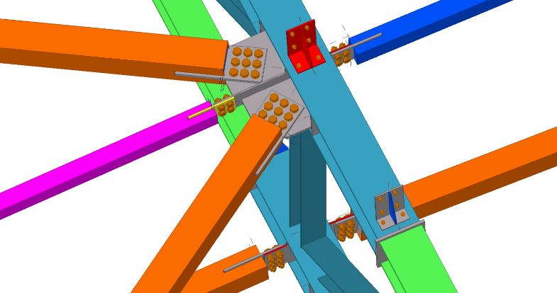
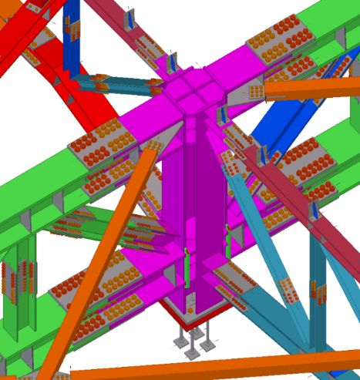
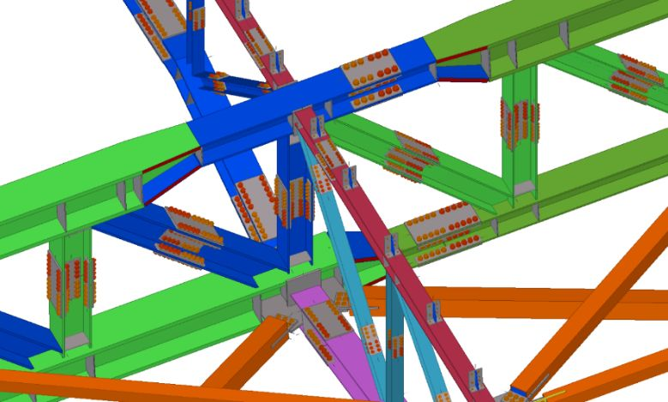
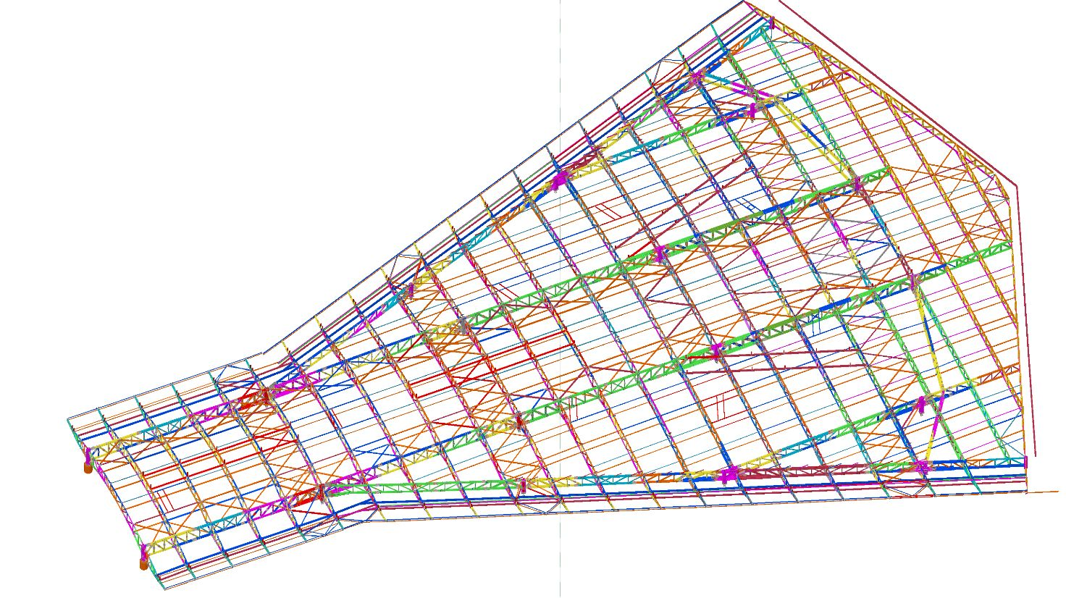
DETAILING
DETAILING IS DONE USING TEKLA MODELLING
COMPLEX STRUCTURES CAN BE DETAILED TO ENSURE NO BOLT CLASHES
TEKLA ALLOWS EASY RESOLUTION TO SITE RELATED ISSUES AND PLAYS A MAJOR PART IN PLANNING ERECTION METHODOLOGY FOR COMPLEX STRUCTURES
STEEL ROOF – TEKLA MODEL

Slide 22
INTEGRATED SAP SYSTEMS
PPC: Planned
Quality : Release
PMG : RFD
Logistic : Packing List
Steps | Department | Responsibility | Activity (SAP Transaction)
1 | PPC | Planning Team | Import all Items and BOM as per drawings, (Production\Production Order: Status = Planned)
2 | Quality | Quality Team | Release of Components (Part mark) wise Production Order in SAP after physical clearance of Parts marks (Production\Production Order: Status = Released)
3 | PMG | Project Managers | Receipt of Part Marks as RFD from Production Orders. (Production\Receipt From Production)
4 | Logistic | Logistics Team | Preparing Packing List only from RFD received by the Project Managers (Sales\Delivery)

Slide 23
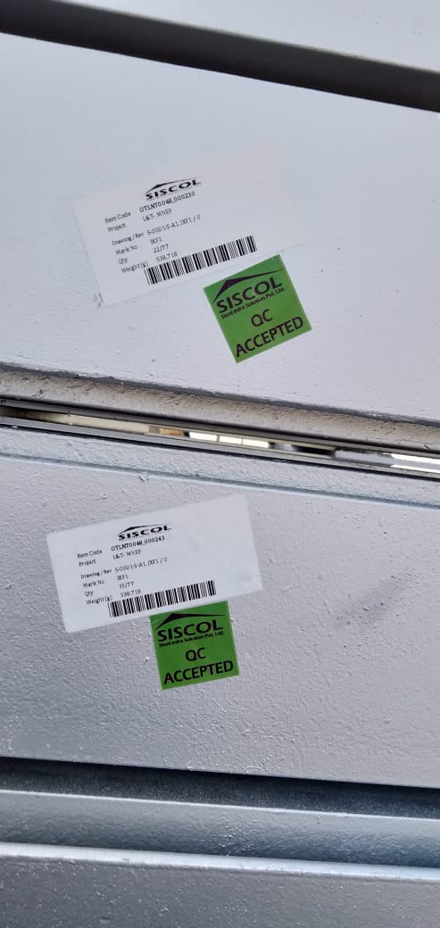
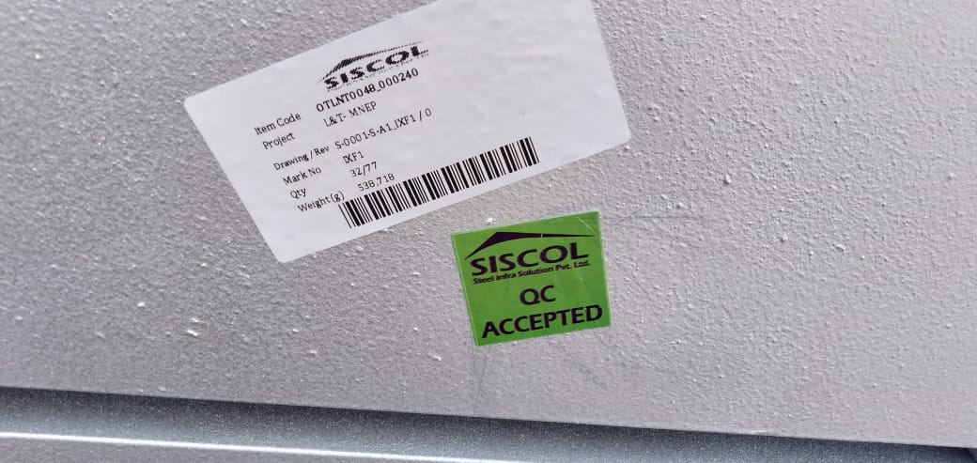
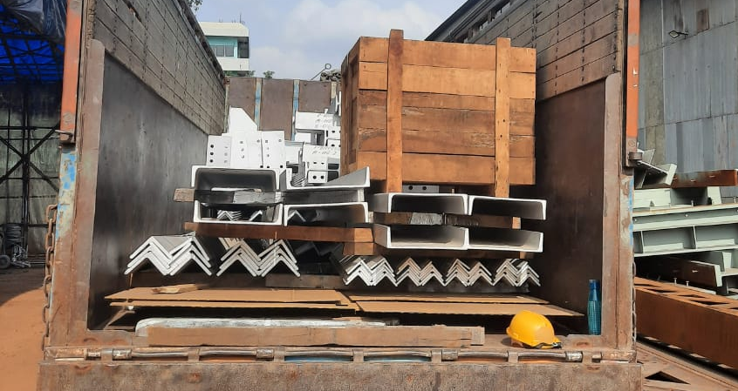
FINISHED GOOD AND LOGISTICS
BAR CODING MENTIONING PART MARK, RELEVANT DRAWING NUMBER ON EACH PART
TRUCKS LOADED AND FASTENED TO ENSURE NO DAMAGES DURING TRANSIT
GPS TRACKING SYSTEM ON TRAILERS TO MONITOR MOVEMENT TILL DESTINATION

Slide 24
FACTORIES AND AUTOMATION

Slide 25
Factory Fabrication Facilities
Unit-1
7 Acres (28328 sq.m)
1500 MT
Unit-2
4 Acres (16187 sq.m)
1000 MT
Unit-3
10 Acres (32234 sq.m)
2000 MT
CNC Machine, GMAW, FCAW, SAW
Industrial, High Rise
CNC Machine, GMAW, FCAW, SAW
Bridges
Industrial, High Rise
CNC Machine, GMAW, FCAW, SAW
Total
34 Acres (112544 sq.m)
6500 MT
All Sectors
Full-Fledged
Equipments
SISCOL Units
Area
Maximum Production Capacity
Specialization
Unit-4
3 Acres
(10117 sq.m )
500 MT
Industrial
GMAW,FCAW,
SAW
Unit-5 (Vadodara)
10 Acres
(25678 sq.m)
1500 MT
Industrial
GMAW,FCAW,
SAW

Slide 26
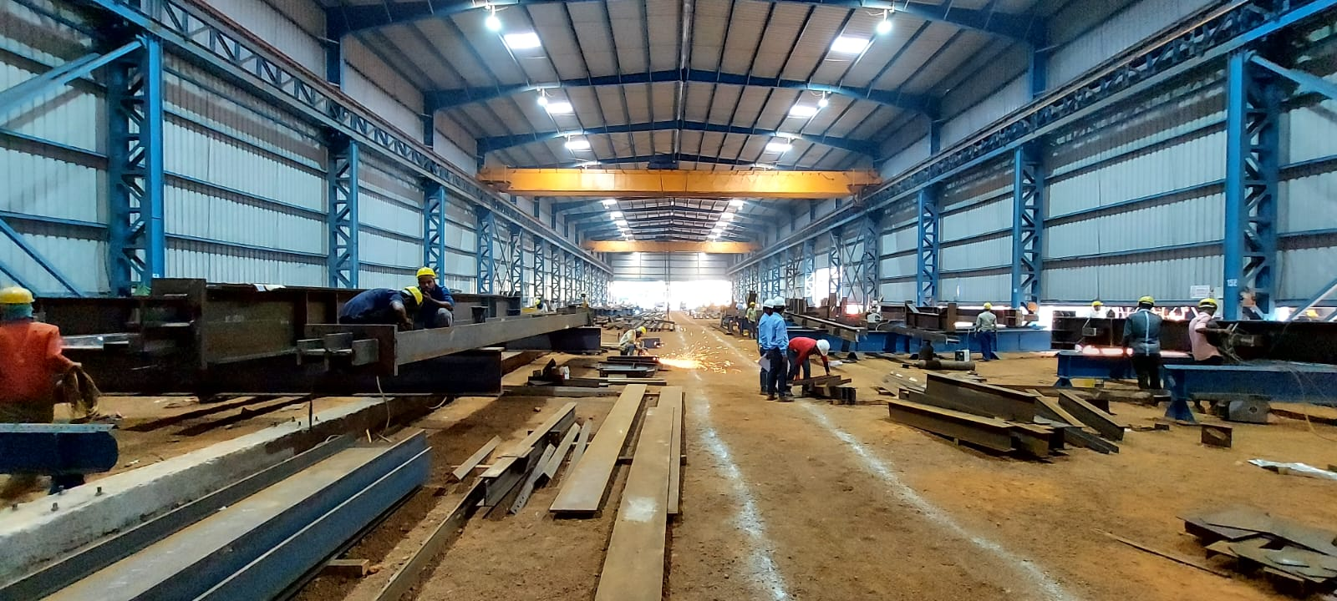

MANUFACTURING UNIT 1
MANUFACTURING UNIT 2
MANUFACTURING UNIT 3
Capacity - 1500 MT
Capacity – 1000 MT
Capacity – 2000 MT
MANUFACTURING UNIT 4
MANUFACTURING UNIT 5
Capacity – 500 MT
Capacity – 1500 MT

Slide 27
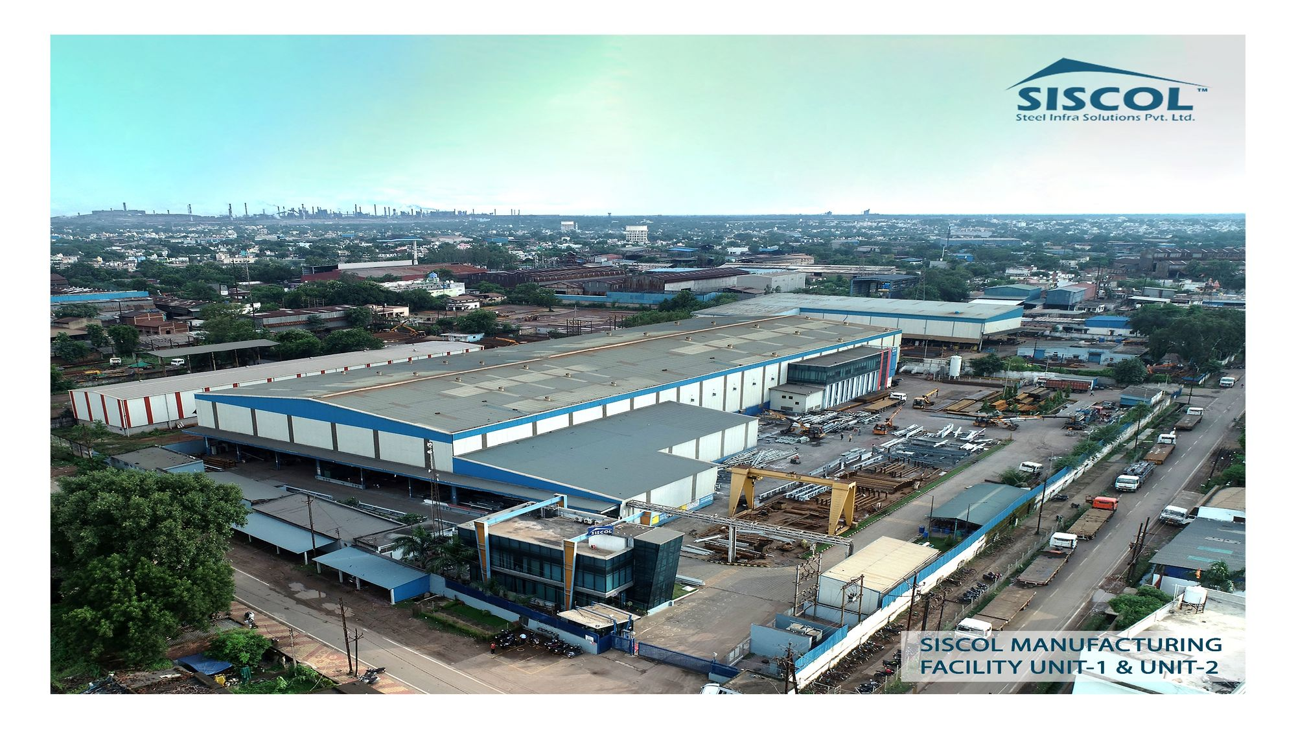

Slide 28
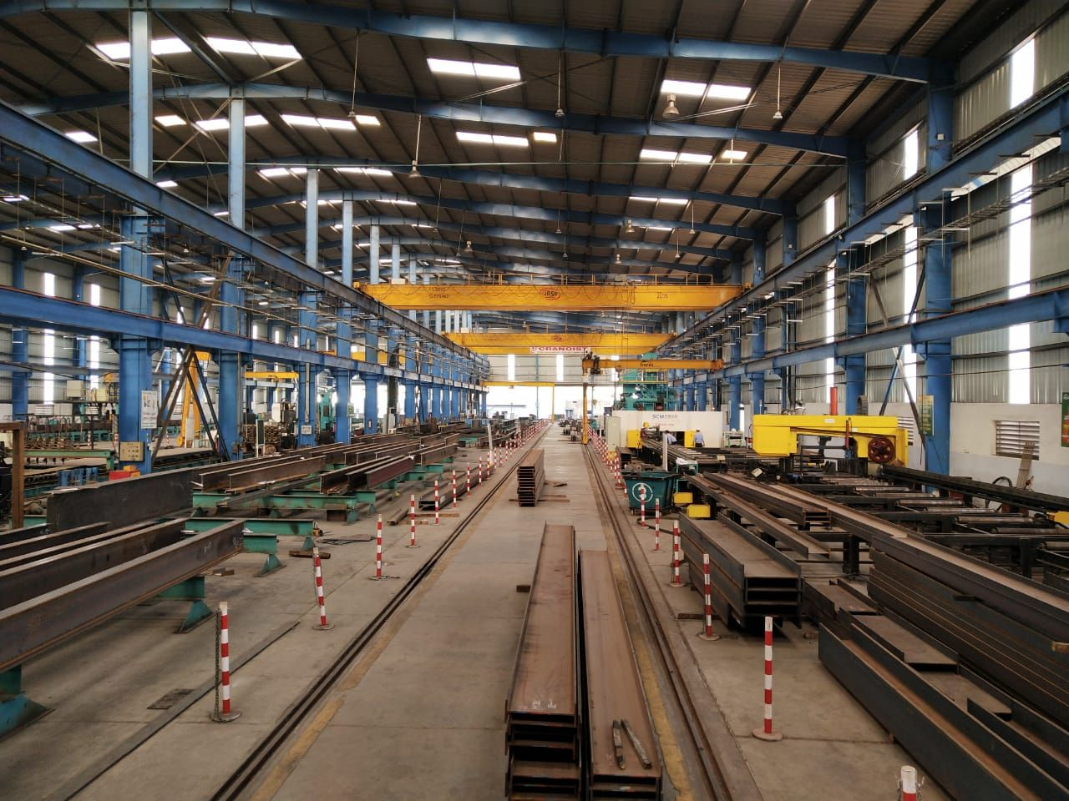
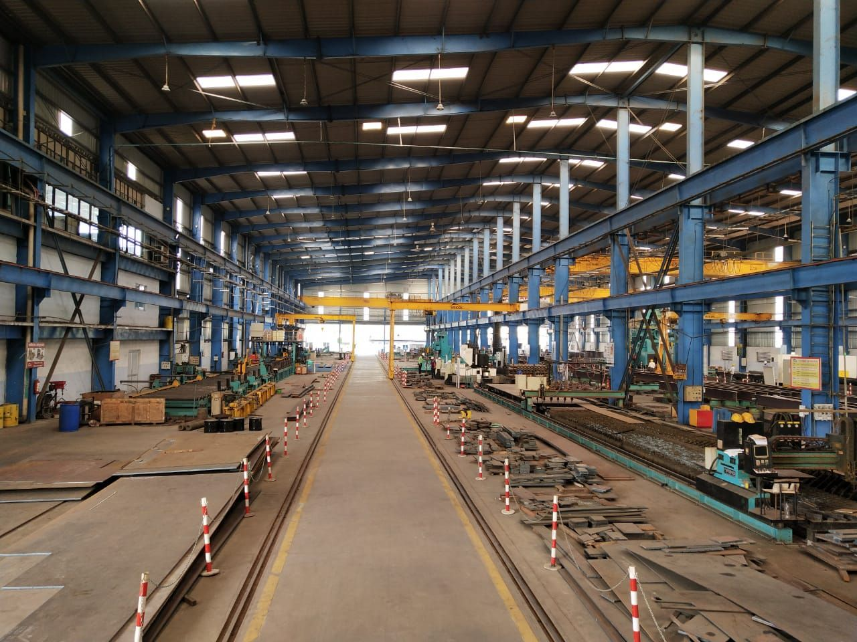

Slide 29
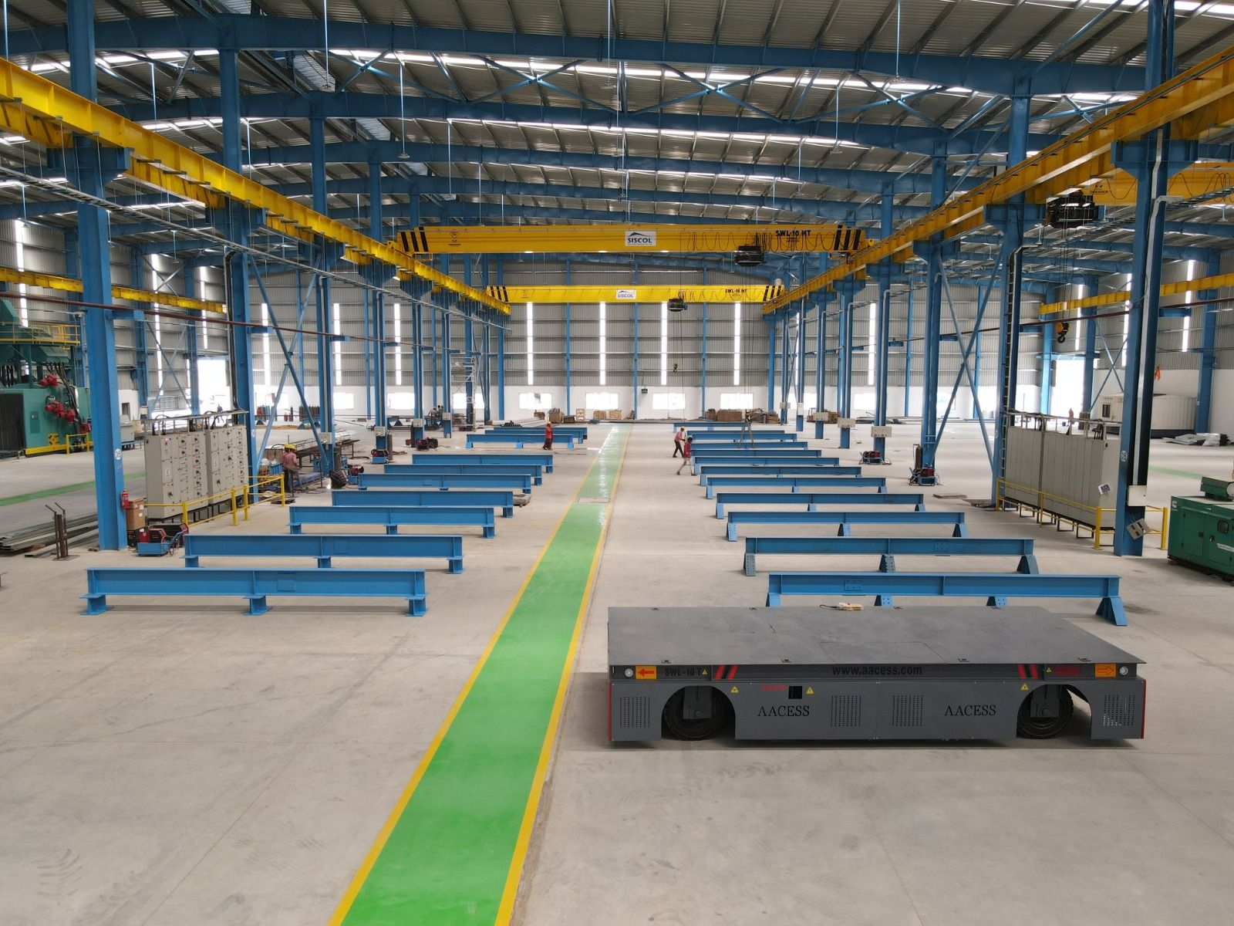
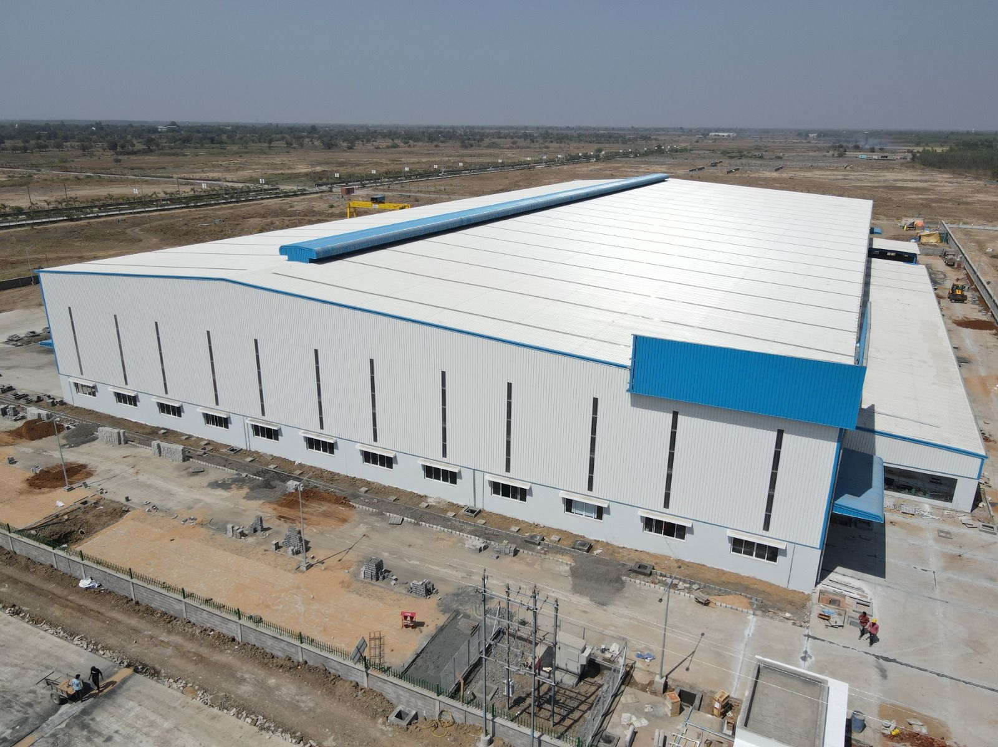
BARODA factory

Slide 30
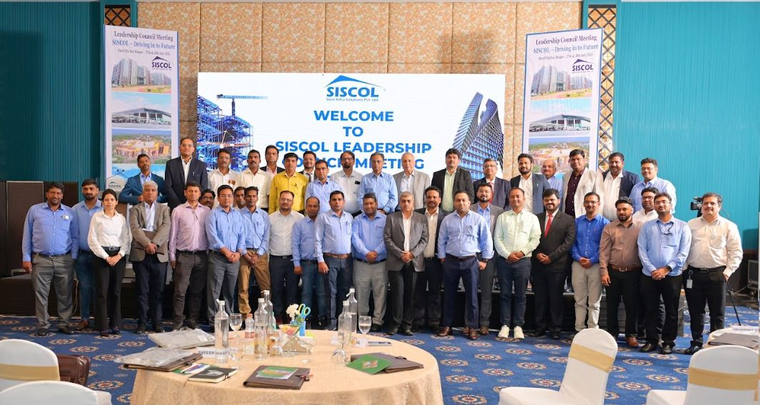
SISCOL Leadership Team
Overall team strength of Bhilai Operations > 1400

Slide 31
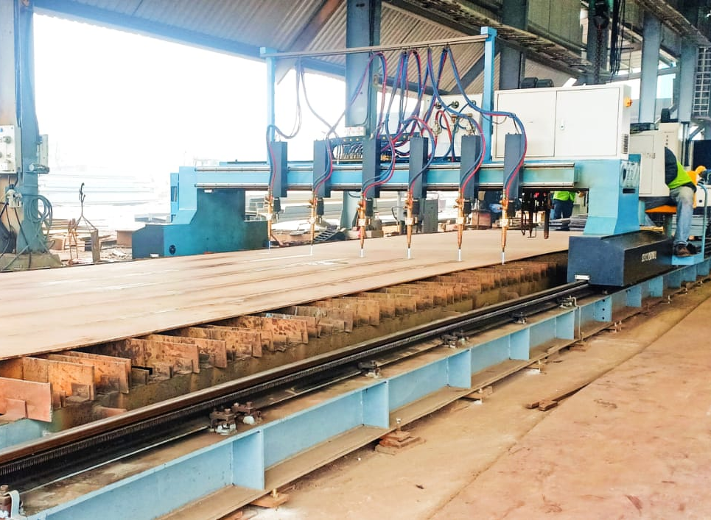
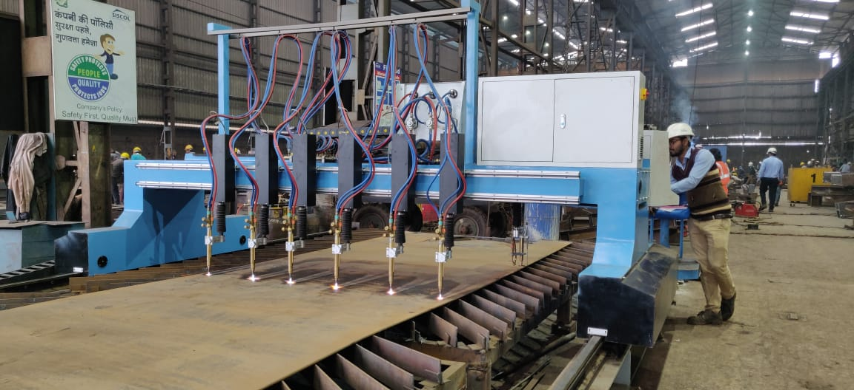
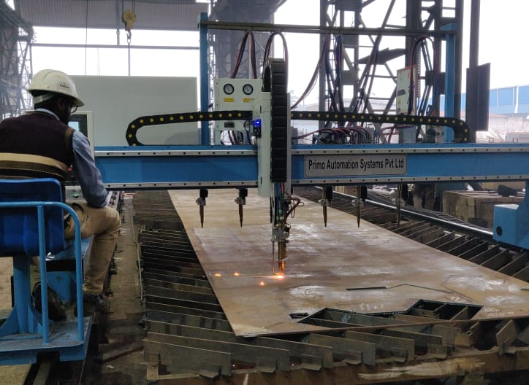
CNC PLASMA AND STRIP CUTTING MACHINES

Slide 32
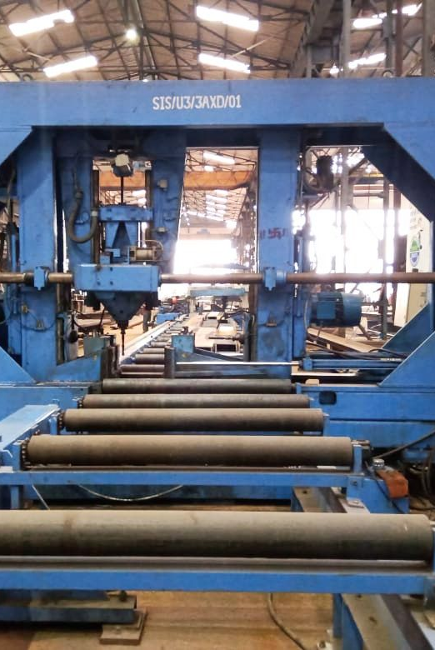
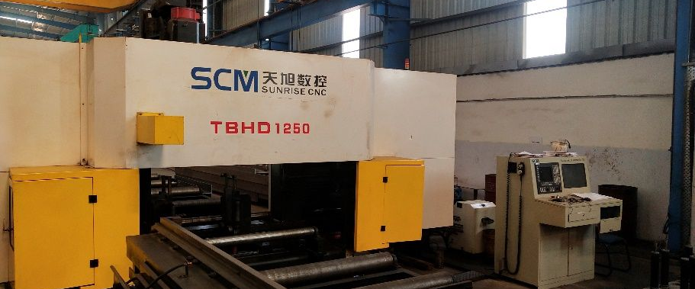
CNC 3-AXIS DRILLING MACHINES

Slide 33
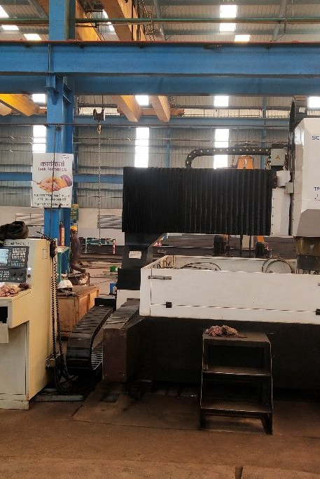

CNC HIGH SPEED DRILLING MACHINES

Slide 34


CNC Band Saw Machine

Slide 35


Automatic Shot Blasting M/c
H-Beam/PTW Machine

Slide 36







Painting Booth System
Straightening Machine
Iron Worker
Laser Pointed SAW M/c
Milling Maching
Radial Drilling Machine

Slide 37






75 MT Crawler Crane
5-50T EOT & 5T Semi Gantry
8 MT Cross Bay Trolley
1500 kVA Transformer
60 MT Weigh Bridge
16 MT Semi Gantry Crane

Slide 38


PAINTING FACILITIES
TOTAL 5 INDEPENDENT PAINT SHOPS AND BLASTING FACILITIES
TOTAL CAPACITY OF PAINTING 4000 MT /MONTH.
ALL PAINT SHOPS ARE EQUIPPED WITH AIRLESS PAINTING MACHINES, COMPRESSORS AND METALIZING EQUIPMENTS.
DRY ABRASIVE SHOT BLASTING FACILITIES AVAILABLE.
CHILLED CI SHOTS, PS BALLS AND COPPER SLAG USED AS BLASTING ABRASIVES.

Slide 39


Logistics Services
SISCOL provides logistic services for safe delivery of finished goods at site.
Our plant has facility of internal weighment of Vehicles with a capacity of 60MT.
All the vehicles are loaded by a team of highly experienced and professional Loaders.

Slide 40
QUALITY ASSURANCE

Slide 41





Quality Vision
Doing right, ‘first time – every time – in time’
Even make it impossible to do wrong things
Thru’
Well trained & dedicated workforce
Proven quality systems & processes; Constantly improved
Automation in manufacturing processes
Digitalization & tech-enabled end-to-end systems
3D modelling & design simulations

Slide 42
Landscape / Footprint
Pre-Bid Activities
Post-Bid Activities
Manufacturing Process (IQC & Client Inspection)
Post delivery interaction and Dossier for project completion & finance activities
Raw Material
Fit-up
CNC first-off
Welding
Surface Preparation
Painting
PDI
Quality
Assurance & Quality Control
(QA-QC)
Pre-Order
Post-Order

Slide 43









Third Party Inspection Agencies at SISCOL
NABL External Labs for Tests, approved by Clients
Shabri Enterprises, Bhilai (Mech, Chem, NDT-AERB Approved)
Perfect Inspection Services, Bhilai (NDT-NABL Approved)

Slide 44
PROJECT MANAGEMENT AND ERECTION SERVICES

Slide 45

SCHEDULING ON MICROSOFT PROJECT

Slide 46
PROJECTS SUMMARY

Slide 47

PRESTIGIOUS CONTRACTS SECURED
INTERNATIONAL HOCKEY STADIUM, ROURKRLA-3600MT
KNRCL Open web bridge girders-52 Mtr Span -14No.
REFINERY STRUCTURE – TECNIMONT, L&T HYDROCARBON, TECHNIP-17000 MT
DELHI AIRPORT EXPANSION 15000 MT
L&T DWARKA CONVENTION CENTRE -10000 MT
FAIRMONT HOTEL, MUMBAI- 4000 MT
TPL-RAMAGUNDAM 6000 MT
DUBAI PORT WORLD WAREHOUSE-JNPT-4000 MT
DLF HIGHRISE BUILDING, DELHI-4000 MT

Slide 48

ORDERS TILL DATE
BRIDGES- 57487 MT
POWER PLANT AND REFINERY STRUCTURES- 1,32,098 MT
BUILDINGS , STADIUMS- 76,454 MT
TOTAL ORDERS TILL DATE 2,66,039 MT
ORDER DELIVERED TILL DATE-2,20,000 MT

Slide 49

DLF DOWNTOWN, GURUGRAM

Slide 50



ITPL- BANGALORE ( 4,050MT)

Slide 51

PATNA MEDICAL COLLEGE

Slide 52



SAIL’S SUPER SPECIALTY HOSPITAL AT ROURKELA

Slide 53


MALL OF INDIA , DLF , NOIDA

Slide 54

KEC THANA MUMBAI

Slide 55

DELHI AIRPORT, T-1

Slide 56




DELHI AIRPORT TERMINAL - 1(DIAL)

Slide 57


BANGALORE INTERNATIONAL AIRPORT

Slide 58

JEWAR INTERNATIONAL AIRPORT UNDER EXECUTION

Slide 59


Slide 60

INTERNATIONAL HOCKEY STADIUM, ROURKELA, ODISHA

Slide 61


Slide 62


Tecnimont Algeria Export material at site

Slide 63

LIST OF PELLET PLANT STRUCTURES DONE BY SISCOL
RUNGTA MINES-CHALIYAMA
SCOPE-4000MT
STATUS- COMPLETED
RUNGTA MINES-KAMANDA,DHENKENAL
SCOPE -6000MT
STATUS- COMPLETED
TATA STEEL
SCOPE- 9000 MT
STATUS- COMPLETED

Slide 64




TECNIMONT PARADIP

Slide 65

TOYO NAYARA

Slide 66


Slide 67

BRIDGE ON KUDAL SANGAM MALAPRABHA RIVER AT KARNATAKA

Slide 68

BRIDGE ON KUDAL SANGAM MALAPRABHA RIVER AT KARNATAKA

Slide 69

2x44 m Bow string bridge

Slide 70


KEC CMRL PORTAL BEAM-380MT

Slide 71


KEC CMRL PORTAL BEAM-380MT

Slide 72


PARDI 15A

Slide 73

Thank you

